Slide 1

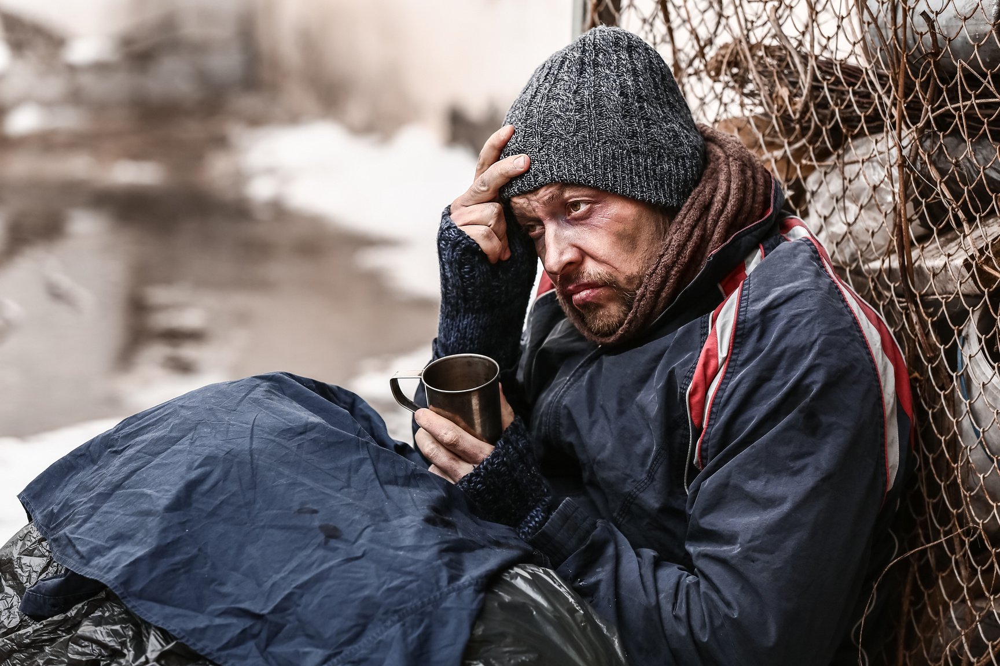
Safeguarding
2. Recognising Abuse
The Hope Hub - egistered charity in England and Wales number 1176452
Notes:
Module 2 of THH Introduction to Safeguarding: Recognising Abuse
This is the second of three short modules that are an essential part of the induction processes for Volunteers and Staff at The Hope Hub.
Volunteers
At the end of the three modules, Volunteers will be asked to complete a short quiz. A score of 10/10 is necessary to complete the training and gain The Hope Hub Certificate: Introduction to safeguarding vulnerable adults for Volunteers.
Staff
At the end of the three modules, Staff will be required to complete a short quiz. A score of 15/15 is necessary to complete the training and gain The Hope Hub Certificate: Introduction to safeguarding vulnerable adults for Staff..

Slide 2
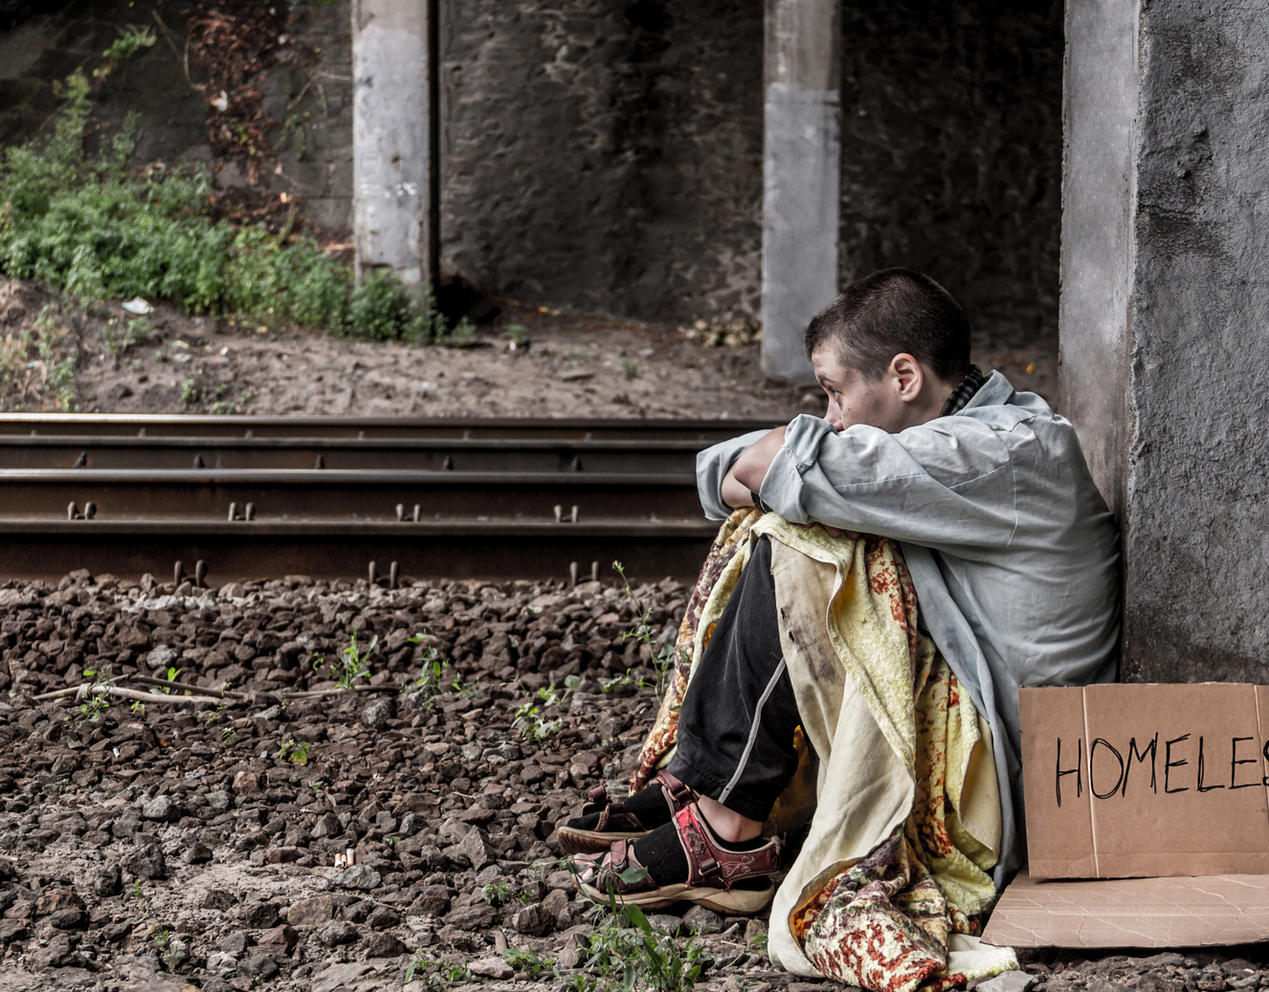
Safeguarding Vulnerable Adults
Recognising Abuse
The Hope Hub
Safeguarding Vulnerable Adults Policy DV20
The Hope Hub - Registered charity in England and Wales number 1176452
Notes:
The Hope Hub induction programmes for Volunteers and for Staff include a requirement to read through and commit to our policies.
This training module links with one key policy 20: Safeguarding Vulnerable Adults.
“Safeguarding is concerned with ensuring a person is free from harm, risk and danger, and that the individual can access the support they need to thrive and do well in life.” (Douglas and Fourie, 2022). It is a vital consideration at The Hope Hub where we aim to serve the needs of vulnerable adults, many of whom have a history of abuse, multiple traumas and highly complex needs.
.
The Hope Hub engage with a wide variety of local partners and professional bodies which helps us to keep up with legislative changes, guidance and best practice in safeguarding vulnerable adults. The Hope Hub is a member of Thirtyone:Eight, an independent organisation providing training and resources to safeguard children and vulnerable adults. These training modules have been reviewed in line with the Thirtyone:Eight Safeguarding Standards and Award.

Slide 3

Safeguarding at The Hope Hub
Induction Training
Your Role and Responsibility
Recognising Abuse
Responding to a Concern
The Hope Hub - Registered charity in England and Wales number 1176452
Notes:
Welcome to this second induction module in Safeguarding at The Hope Hub.
Safeguarding is everyone’s responsibility at The Hope Hub and consequently everyone needs a level of understanding about what this means in practice.
Volunteers, Staff, Designated Leads for Safeguarding and Trustees all undertake training in safeguarding that reflect their roles and responsibilities with vulnerable adults and the team at The Hope Hub.
Volunteers: Please focus on the slides – any information on the notes page is primarily aimed at staff and not included in your quiz.
Staff: Please scan the notes pages for any gaps in your knowledge. You will be expected to score 15/15 to achieve the THH Certificate Introduction to Safeguarding Vulnerable Adults and questions will be more challenging than those designed for the Volunteers.

Slide 4
Recognising Abuse
Aims and Objectives
On completion of this training module you should have a better understanding of how to recognise:
  The categories of abuse defined in legislation/human rights.
  Some of the other related contemporary concerns.
  Signs and indicators of harm.
The Hope Hub - Registered charity in England and Wales number 1176452
Notes:
This second module will help you to recognise different types and combinations of abuse and neglect. Once you have a good understanding of these, you will be in a better position to respond to them quickly and effectively.
If you anticipate that this subject might act as a trigger and cause you distress, please do not go any further. Instead, contact one of the safeguarding team at The Hope Hub and agree a different pathway through the induction programme.
The way abuse and neglect are defined varies a little across the four nations of the UK. We will consider the ten types of abuse currently identified in English law and then look at some other contemporary safeguarding concerns. This makes the module longer than the others in the series, so we suggest taking a pause in the middle.
This module also considers some of the signs and indicators associate with abuse and neglect. The note section is written as a reference document for you to refer to in the future so please keep it for when you need a refresher.

Slide 5
Safeguarding: Recognising Concerns
Recognise
Respond
Record
Report
Reflect
These five steps can be a helpful way to guide us through the process of responding well to safeguarding concerns, allegations or disclosures.
At The Hope Hub, it is everyone’s responsibility to know how to recognise and respond to concerns. Our trained Safeguarding Officers take more responsibility for guiding the process thereafter to meet the needs of every individual.
The Hope Hub - Registered charity in England and Wales number 1176452
Notes:
The Hope Hub training modules guide you through each step in the process of recognising and responding appropriately to concerns. These Five R’s as they are referred to, are used across all services, charities and government bodies. They frame our thoughts and actions from initial hints of concern and protecting others through to submitting evidence used to convict perpetrators.
Please do not feel overwhelmed by the process. Our Safeguarding team at The Hope Hub will support and guide you through any concerns and disclosures. What matters is that you share any concerns you have with one of them. The previous presentation 1 Safeguarding: Your Role and Responsibility provides more information to support this.
Camilla Spicer, Head of Service Delivery 07543 429823 / 01276 581174 camilla.spicer@thehopehub.org.uk
Clare McCord, Day Services Manager 07543 429823 / 01276 743053 clare.mccord@thehopehub.org.uk
Gemma Johnston, Head of Grants/Fundraising and Marketing 07359 532731 / 01276 581174 gemma.Johnston@thehopehub.org.uk
Tristan Barrington-Waite, EAS Manager 07926 427235 / 01276 581174
Designated Lead for Safeguarding at The Hope Hub Mags Mercer, CEO and David Reed, Safeguarding Trustee

Slide 6
Safeguarding: Recognising Concerns
Recognise
Respond
Record
Report
Reflect
The first step to responding well to concerns is to recognise that a person may be at risk of harm or abuse.
This presentation is about recognising potential signs of abuse and neglect.
The Hope Hub - Registered charity in England and Wales number 1176452
Notes:
The first step in responding well to concerns is to recognise and identify that a person may be at risk of harm or abuse. Staff, volunteers and visitors may recognise a concern in one of two ways:
1. By spotting the signs or indicators of abuse - these are things that you may see or hear, or things that another person tells you. We will address this in this module.
2. When a person makes a disclosure of abuse - this is when a person tells you about their experience of abuse or comes to you for help. We’ll consider this in the third module on safeguarding along with how to respond to a serious incident..

Slide 7
Safeguarding: Responding to Concerns
Recognise
Respond
Record
Report
Reflect
Please also familiarise yourself with The Hope Hub presentation for Staff and Volunteers: Safeguarding Vulnerable Adults – Responding to a Concern which includes guidance on how to respond, record and report a concern, allegation or disclosure. This can be found on the Volunteers Webpages at The Hope Hub.
The Hope Hub CEO, Senior Managers and Trustees routinely review and reflect upon how safeguarding concerns are handled as this informs improvements in policies and practice at THH.
The Hope Hub - Registered charity in England and Wales number 1176452
Notes:
The third shorter induction module include guidance on how to respond, record and report a concern, allegation or disclosure. This and The Hope Hub’s policies for Safeguarding can be found on the Volunteers’ Webpages at The Hope Hub and paper copies are available at the Volunteer Station, and in the main offices at both locations.
As part of their induction process, all staff and volunteers sign to agree that they have read and know where to find The Hope Hub’s Safeguarding Policies. A list of relevant policies is included at the end of this module.
The Hope Hub CEO, Senior Managers and Trustees routinely review and reflect upon how safeguarding concerns are handled as this informs improvements in policies and practice at THH.

Slide 8

Adult abuse
Abused adults
can take many forms and be invisible to others, yet it can cause the abused to suffer pain, fear and distress extending far beyond the occasion of the actual incident or incidents.
may be too afraid or embarrassed to raise a concern or complaint. They may be reluctant to discuss their concerns with others or be unsure who to trust or approach with their worries.
The Hope Hub - Registered charity in England and Wales number 1176452
Notes:
What do we mean by ‘abuse’.
Abuse is a single or repeated act, or lack of action, that happens within any relationship where there is an expectation of trust, which causes harm or distress to another person or violates their human or civil rights.
It is the misuse of power and control and can be perpetrated by a wide range of people, including those who are close to the person or those who have no previous connection to them.
Some of our Service Users experienced abuse or neglect in their childhood and others have experienced abuse more recently. As such, team Hope Hub follow a Trauma Informed Approach which you will learn more about as you progress through your induction programme.
Please keep this handout for future reference. Keep up with annual changes and improvements to the THH Safeguarding Policies and know where to find them at short notice.

Slide 9
Types of Abuse
Physical
Emotional/ Psychological
Neglect
Sexual
Domestic
Financial
Self-Neglect
Modern Slavery
Discriminatory
Organisational
The Hope Hub - Registered charity in England and Wales number 1176452
Notes:
Abuse and neglect may take many forms and combine in different ways. These examples focus on vulnerable adults. Children may experience additional types of abuse from organisations, adult perpetrators and from each other.
Before a short break, we will consider these ten types of abuse defined in English Law.

Slide 10
Other Contemporary Concerns
Cuckooing
Online Harm
Spiritual Abuse
Forced Marriage
Female Genital Mutilation
Chemical Control
Radicalisation
Extremism
Self-Harm
Stalking
Mate & Hate Crime
Romance Fraud
The Hope Hub - Registered charity in England and Wales number 1176452
Notes:
At The Hope Hub we also need to be aware of other contemporary safeguarding concerns we hear about and work with, such as those above.
Some of these we will touch in this section, others we will address briefly towards the end of this module and provide links for further information and help lines where possible. Remember, it is the safeguarding team at THH who will carry this through, but you may wish to understand the issues in greater depth.

Slide 11
Signs and Indicators of Abuse
A sign or indicator on its own will not necessarily mean that abuse is taking place, so knowing who to report concerns to is important so that risks are assessed and appropriate action can be taken.
There may not always be obvious physical signs of abuse, but conversations may give indications that a Service User needs help.
Know the possible signs and indicators that may point to something being wrong that needs to be addressed.
The Hope Hub - Registered charity in England and Wales number 1176452
Notes:
Signs and indicators
Knowing the possible signs and indicators of harm and abuse can help you to be alert to concerns and help The Hope Hub to keep people safe.
Everyone at THH (trustees, staff and volunteers) should receive training to help them spot the signs and indicators of abuse, and to know how to respond.
There may not always be obvious physical signs of abuse, but conversations may give indications that a Service User needs help.
A sign or indicator on its own will not necessarily mean that abuse is taking place, so knowing who to report concerns to is important so that appropriate action can be taken.
Some level of emotional abuse is usually present in all types of abuse or neglect, but can also occur on its own.

Slide 12
Recognising Physical Abuse
The deliberate use of physical force by one person against another to cause harm.
For example, hitting, pushing, shaking, inappropriate restraint, force-feeding, forcible administration of medication, burning, physical neglect or abandonment.
Possible signs and indications
Visible injuries and bruising. Unexplained cuts, marks or scars. Injuries that don't match the explanation given. Getting injured often. Unexplained falls. Subdued or changed behaviour. Changes in weight, being excessively under or overweight or malnourished. Failing to get medical treatment or changing Doctors often.
The Hope Hub - Registered charity in England and Wales number 1176452
Notes:
Physical abuse is the deliberate use of physical force by one person against another to cause harm. It may result in physical harm or injury to the other person, or it may not, it may be a one-off act or ongoing.
Physical abuse can include:
Hitting, slapping, biting or pinching. Rough handling, shaking, pushing, or throwing.
Burning or scalding. Drowning, or suffocating. Poisoning, misuse of medication or the denial of treatment. Intentional exposure to extreme heat or cold, or force feeding.
Misuse or illegal restraint, inappropriate physical punishment, or depriving someone of their liberty.
Physical harm may also be caused when a Carer fakes the symptoms of or deliberately causes illness or ill health in a person
Injuries caused by accidents such as trips and falls are not uncommon, but these usually occur on bony or prominent areas such as knees, shins and elbows.
Abusive injuries tend to involve softer areas that are harder to damage accidentally e.g. upper arms, forearms, chest, back, abdomen and thighs.
Possible signs and indicators:
Visible injuries and bruising. Unexplained cuts, marks or scars. Injuries that don't match the explanation given. Getting injured often. Unexplained falls. Subdued or changed behaviour. Changes in weight, being excessively under or overweight or malnourished. Failing to get medical treatment or changing Doctors often.

Slide 13
Recognising Emotional Abuse
Any persistent emotional ill-treatment that causes severe and long-lasting adverse effects on a person’s emotional development.
For example, regularly telling someone that they are worthless, unloved or inadequate. Using intimidation, coercion, and harassment. Bullying, including online bullying. Undermining their ability to share their views. Frequent evocation of fear, mistreatment or danger.
Possible signs and indications
Low self-esteem, attachment issues, depression, self-harm, and eating disorders. Signs of distress, tearfulness or anger. Reluctance to be alone with a particular person.
The Hope Hub - Registered charity in England and Wales number 1176452
Notes:
Emotional abuse (or Psychological abuse) involves harming a person emotionally and includes any persistent emotional ill-treatment that causes severe and long-lasting adverse effects on a person’s emotional development.
Some level of emotional abuse is present in all types of abuse and ill treatment of one person by another, but it can also occur on its own.
Emotional abuse can include:
Consistently telling someone that they are worthless, unloved or inadequate.
Using intimidation, coercion, and harassment.
Having inappropriate expectations for a person’s age or development.
Seeing or hearing another person being mistreated, such as in domestic abuse.
Not giving someone opportunity to express their views or to take part in normal social interaction.
Bullying, including online bullying.
Causing someone to frequently feel frightened or in danger.
Possible signs and indicators:
Low self-esteem, attachment issues, depression, self-harm, and eating disorders.
Signs of distress, tearfulness or anger
Reluctance to be alone with a particular person

Slide 14
Recognising Neglect
The failure to meet a person’s basic physical or emotional needs which is likely to have a serious negative impact on their health or development.
Neglect can include:
Not providing adequate food, clothing, or assistance with personal hygiene.
Not providing adequate shelter and heating. Failing to protect someone from harm or danger. Not ensuring appropriate supervision (including the use of inadequate care-givers). Failing to give prescribed medication or provide access to appropriate health care or treatment. Failing to provide access to educational services. Ignoring a person's basic emotional needs. Failing to take action when a person is taking unnecessary risk (especially when the person lacks capacity to properly assess risk).
The Hope Hub - Registered charity in England and Wales number 1176452
Notes:
Neglect (or acts of omission) is the failure to meet a person’s basic physical or emotional needs which is likely to have a serious negative impact on their health or development.
It happens when a person deliberately withholds or fails to provide an appropriate level of care and support which is needed by another person.
It can involve a Parent/Carer and can also happen during pregnancy e.g. as a result of maternal substance abuse.
Neglect may happen because of a lack of knowledge or awareness, or through a failure to take reasonable action whether deliberate or not.
In its extreme form, neglect can be a significant risk as it can lead to serious long-term effects and even be life-threatening.
Neglect is the most common form of child abuse in the UK.
Neglect can include:
Not providing adequate food, clothing, or assistance with personal hygiene.
Not providing adequate shelter and heating.
Failing to protect someone from harm or danger.
Not ensuring appropriate supervision (including the use of inadequate care-givers)
Failing to give prescribed medication or provide access to appropriate health care or treatment.
Failing to provide access to educational services.
Ignoring a person's basic emotional needs.
Failing to take action when a person is taking unnecessary risk (especially when the person lacks capacity to properly assess risk).

Slide 15
Recognising Neglect
The failure to meet a person’s basic physical or emotional needs which is likely to have a serious negative impact on their health or development.
Reflection: What percentage of Service Users at The Hope Hub fit this category now or in their past?
Possible signs and indications
Poor appearance or hygiene. Living in an unsuitable home environment Signs of malnutrition or hunger. Being withdrawn, depressed or anxious. Tiredness or finding it hard to concentrate or take part in activities. Self-soothing behaviours such as drug or alcohol misuse and self-harm. Poor school attendance or performance.
The Hope Hub - Registered charity in England and Wales number 1176452
Notes:
Neglect
Possible signs and indicators:
Poor appearance or hygiene e.g. being smelly or dirty
Living in an unsuitable home environment e.g. having no heating
Inappropriate or inadequate clothing
Signs of malnutrition or not being given enough food
Having frequent and untreated medical issues or an accumulation of untaken medication.
Body issues such as sores, skin complaints, poor muscle tone or prominent joints.
Poor language or social skills
Being left alone for a long time
Being withdrawn, depressed or anxious
Tiredness or finding it hard to concentrate or take part in activities
Self-soothing behaviours such as drug or alcohol misuse and self-harm.
Poor school attendance or performance

Slide 16
Recognising Sexual Abuse
Any behaviour perceived to be of a sexual nature which is unwanted or takes place without consent or understanding.
For example, Penetrative or non-penetrative sexual acts, whether they aware or not. Indecent exposure, sexual harassment, inappropriate looking or touching, groping, sexual teasing or innuendo. Being made to look at or be involved in the production of sexually abusive material. Stalking, grooming.
Possible signs and indications
Physical injuries and bruising. Bleeding, pain or itching in the genital area. Sexually transmitted diseases or infections. Unwanted pregnancy. Changes in sexual behaviour/attitudes. Self-harming. Poor concentration, withdrawal, sleep disturbance. Fear/apprehension of being alone with a particular person.
The Hope Hub - Registered charity in England and Wales number 1176452
Notes:
Sexual abuse (or Sexual violence) is any behaviour perceived to be of a sexual nature which is unwanted or takes place without consent or understanding.
The abuse may involve physical contact and touching or non-contact activities.
Sexual abuse is found across all sections of society, irrelevant of gender, age, ability, religion, race, ethnicity, personal circumstances, financial background or sexual orientation. It can be perpetrated by family or non-family members, women, men and other children.
Sexual abuse of Adults involves sexual acts to which the person has not consented or has been pressured into consenting to. It can include:
Penetrative or non-penetrative sexual acts, whether they are aware of what is happening or not eg. sexual assault, oral sex, rape, attempted rape, chemical control and date rape. Indecent exposure, sexual harassment, inappropriate looking or touching, groping, sexual teasing or innuendo, Being made to look at or be involved in the production of sexually abusive material or being made to watch sexual activities. Stalking and grooming.
Possible signs and indicators:
Physical injuries and bruising, particularly to the thighs, buttocks, upper arms and neck. Bleeding, pain or itching in the genital area or when walking or sitting. Sexually transmitted diseases or infections. Pregnancy in a woman who is unable to consent to sex. Uncharacteristic or age-inappropriate use of sexual language or significant changes in sexual behaviour or attitude. Self-harming. Poor concentration, withdrawal, sleep disturbance. Excessive fear/apprehension of, or withdrawal from, relationships or being alone with a particular person.

Slide 17
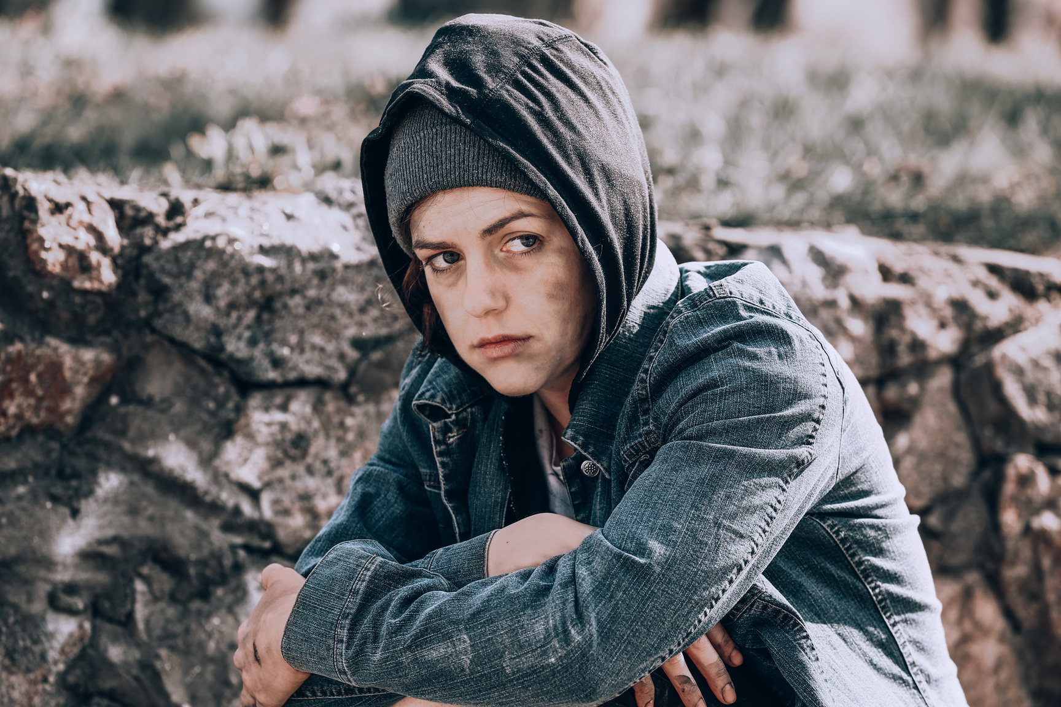
Case Study
The Hope Hub - Registered charity in England and Wales number 1176452

Slide 18
Recognising Domestic Abuse
Any threatening behaviour, violence, or abuse by one adult against another where they are or have been intimate partners or family members.
Domestic abuse can include Emotional abuse, Physical abuse, Sexual abuse, Financial abuse, Forced Marriage, FGM and ‘honour crimes’
Possible signs and indications
Visible injuries and bruising. Unexplained cuts, marks or scars. Injuries that don't match the explanation given. Getting injured often. Unexplained falls. Subdued or changed behaviour. Changes in weight, being excessively under or overweight or malnourished. Failing to get medical treatment or changing Doctors often.
The Hope Hub - Registered charity in England and Wales number 1176452
Notes:
Domestic abuse (or Domestic Violence) is any incident, or pattern of incidents, of controlling coercive or threatening behaviour, violence, or abuse by one adult against another where they are or have been intimate partners or family members.
It can include violence by a son, daughter, mother, father, husband, wife, life-partner, sibling, grandparent or by an extended family member, whether they are directly related, in-laws or step-family. It happens across all sections of society, regardless of gender, age, ability, religion, race, ethnicity, financial background or sexual orientation.
Both men and women can be victims, although a greater number of women experience domestic abuse and are more likely to be seriously injured or killed because of it. It is usually frequent and persistent, can happen inside and outside the home, and can continue even after a relationship has ended.
Domestic abuse can include: Emotional abuse, Physical abuse, Sexual abuse, Financial abuse, Forced Marriage, FGM and ‘honour crimes’
Possible signs and indicators:
Low self-esteem, attachment issues, depression, self-harm, and eating disorders. Signs of distress, tearfulness or anger. Reluctance to be alone with a particular person. Visible injuries and bruising. Injuries that don't match the explanation given. Unexplained falls. Subdued or changed behaviour. Changes in weight, being excessively under or overweight or malnourished. Signs of coercive control. Feeling that the abuse is their fault when it is not. Isolation – not seeing friends and family. Limited access to money

Slide 19
Understanding Coercive Control
Domestic, financial, sexual, online or otherwise
Coercive control is an act or a pattern of acts of assault, threats, humiliation and intimidation or other abuse used to harm, punish, or frighten another person. It is designed to make a person subordinate or dependent by isolating them from sources of support, exploiting them and their resources, depriving them of the means needed for independence, resistance and escape, and regulating their everyday behaviour.
The Hope Hub - Registered charity in England and Wales number 1176452
Notes:
Domestic abuse can include: Emotional abuse, Physical abuse, Sexual abuse, Financial abuse, Forced Marriage, FGM and ‘honour crimes’
Coercive control
Coercive control is an act or a pattern of acts of assault, threats, humiliation and intimidation or other abuse used to harm, punish, or frighten another person. It is designed to make a person subordinate or dependent by isolating them from sources of support, exploiting them and their resources, depriving them of the means needed for independence, resistance and escape, and regulating their everyday behaviour.
Domestic Abuse Helpline: Home | Refuge National Domestic Abuse Helpline
(nationaldahelpline.org.uk)
Restored https://www.restored-uk.org/
National Centre for Domestic Violence: Domestic Abuse Help · National Centre
for Domestic Violence https://www.ncdv.org.uk/domestic-abuse-help/
Refuge: Home – Refuge https://refuge.org.uk
Women’s Aid: I need help - information and support on domestic abuse
https://www.womensaid.org.uk/information-support/
DAVE (Domestic Abuse Victim Empowerment) Male Victim Domestic Abuse
Support – Dads Unlimited https://www.dadsunltd.org.uk/services/dave/

Slide 20
Recognising Financial Abuse
The attempted or actual misappropriation or misuse of a person's money, property, benefits, or other assets, by ways to which the person does not or can not consent.
For example, theft, burglary, or fraud. Exploitation and embezzlement. Coercion or being put under pressure concerning a person's finances (including wills, property, inheritance or financial transactions). Misuse or misappropriation of property, possessions or benefits. Withholding pension or other benefits.
Possible signs and indications
Unusual financial activity, substantial gifts, involvement of a third party. Complaints that personal property is missing. Signs of coercive control or neglect.
The Hope Hub - Registered charity in England and Wales number 1176452
Notes:
Financial abuse (or Material abuse) is the attempted or actual misappropriation or misuse of a person's money, property, benefits, or other assets, my means of intimidation, coercion, deception, or other ways to which the person does not or can not consent to. Financial abuse includes having money or other property stolen, being defrauded or put under pressure in relation to money or other property, and having money or other property misused.
Financial abuse can include:
Theft, burglary, or fraud (including internet scamming).
Exploitation and embezzlement.
Coercion or being put under pressure concerning a person's finances (including wills, property, inheritance or financial transactions).
Misuse or misappropriation of property, possessions or benefits.
Withholding pension or other benefits.
Possible signs and indicators:
Unusual financial activity such as making an unexpected change to a will, a sudden sale or transfer of a property, or unusual activity in a bank account.
Sudden inclusion of additional names on a bank account or where a signature does not resemble the person’s normal signature.
Reluctance or anxiety by a person when discussing their finances.
A substantial gift to a carer or other third party.
A sudden interest by a relative or other third party in the welfare of the person.
Bills remaining unpaid.
Complaints that personal property is missing.
Signs of coercive control or neglect.

Slide 21
Recognising Organisational Abuse
When a person is abused or mistreated within an institution or by an organisation.
The abuse may happen because of a culture that denies or restricts privacy, dignity, choice and independence, and involves the collective failure of a service provider or an organisation to provide safe and appropriate services, and to ensure that the necessary preventative and protective measures are in place.
Possible signs and indications
Signs of neglect, physical or emotional abuse. Poor standards of care, social, recreational or educational activities. Unnecessary exposure during care routines. Lack of adequate procedures.
The Hope Hub - Registered charity in England and Wales number 1176452
Notes:
Organisational abuse (or Institutional abuse) is when a person is abused or mistreated within an institution such as a care home or hospital, or by an organisation providing care in the person's own home.
It can include one-off incidents or long-term mistreatment and can be through neglect or poor professional practice as a result of inadequate resources, structures, policies, processes and practices within an organisation.
The abuse may happen because of a culture that denies or restricts privacy, dignity, choice and independence, and involves the collective failure of a service provider or an organisation to provide safe and appropriate services, and to ensure that the necessary preventative and protective measures are in place.
Organisational abuse can include:
A run-down or overcrowded environment.
Insufficient staff or high staff turnover resulting in poor quality care.
Abusive and disrespectful attitudes towards people using the service.
Not offering choice or promoting independence.
Possible signs and indicators:
Signs of neglect. Signs of physical or emotional abuse.
Inadequate staffing levels. Poor standards of care. Lack of adequate procedures.
Absence of visitors. Few social, recreational and educational activities.
Unnecessary exposure during bathing or using the toilet.
Lack of management overview and support.

Slide 22
Recognising Modern Slavery
The recruitment, movement, and holding of a person by improper means, such as force, threat or deception, for the purposes of exploitation or abuse.
For example, forced or bonded labour, private fostering, domestic servitude, sexual exploitation such as prostitution and pornography, criminal activity, forced marriage.
Possible signs and indications
Signs of physical or emotional abuse or neglect. Isolation from the community. Seeming under the control or influence of others. Lack of personal effects or identification documents. Avoidance of eye contact. Fear of law enforcers.
The Hope Hub - Registered charity in England and Wales number 1176452
Notes:
Modern slavery (or Human Trafficking) is the recruitment, movement, and holding of a person by improper means, such as force, threat or deception, for the purposes of exploitation or abuse.
Victims of human trafficking can be male or female, children or adults, and may come from migrant or indigenous communities. Modern slavery is different from illegal immigration as people who are trafficked are tricked, coerced, lured or forced by criminals to work for them or others in their criminal networks around the world.
People are forced into and held by threats of violence and intimidation against them or their family, fear, debt bondage, isolation and the removal of identification or travel documents, or imprisonment and torture.
Modern slavery can include:
Forced labour. Bonded labour (forcing someone to pay a debt that can't be paid).
Domestic servitude. Sexual exploitation such as prostitution and pornography.
Criminal activity. Private Fostering. Forced Marriage
Possible signs and indicators:
Signs of physical abuse or emotional abuse. Signs of neglect.
Isolation from the community. Seeming under the control or influence of others.
Lack of personal effects or identification documents. Fear of law enforcers.
Avoidance of eye contact, appearing frightened or hesitant to talk to strangers

Slide 23
Recognising Modern Slavery
Case Study / Video
The Hope Hub - Registered charity in England and Wales number 1176452
Notes:
Signposting and Links
Anti-Slavery International: What is modern slavery? | Anti-Slavery International
https://www.antislavery.org/slavery-today/modern-slavery/
Modern Slavery Helpline: Modern Slavery Helpline https://www.modernslaveryhelpline.org
The Clewer Initiative: The Clewer Initiative | The Clewer Initiative https://theclewerinitiative.org
Unseen: Home - Unseen (unseenuk.org) https://www.unseenuk.org
https://www.a21.org/index.php
https://www.gov.uk/government/publications/a-typology-of-modern-slavery-
offences-in-the-uk

Slide 24
Recognising Discriminatory Abuse
When a person is treated unfairly, bullied, or abused because of a particular characteristic.
Protected Characteristics include: Age | Disability | Gender reassignment | Marriage and civil partnership | Pregnancy and maternity | Race | Religion or belief | Sex | Sexual orientation.
Possible signs and indications
Low self-esteem, attachment issues, depression, self-harm, and eating disorders. Signs of distress, tearfulness, anger or anxiety. The person appears withdrawn and isolated. The support on offer does not take account of the person’s individual needs in terms of a protected characteristic.
The Hope Hub - Registered charity in England and Wales number 1176452
Notes:
Discriminatory abuse
Discriminatory abuse is when a person is treated unfairly, bullied, or abused because of a particular characteristic. It is against the law to discriminate against someone because of:
Age
Disability
Gender reassignment
Marriage and civil partnership
Pregnancy and maternity
Race
Religion or belief
Sex
Sexual orientation
These are called protected characteristics.
Discriminatory abuse links to other forms of abuse and may have similar effects e.g. physical abuse motivated by racism would be classified as Discriminatory abuse.
Possible signs and indicators:
Low self-esteem, attachment issues, depression, self-harm, and eating disorders.
Signs of distress, tearfulness, anger or anxiety. The person appears withdrawn and isolated. The support on offer does not take account of the person’s individual needs in terms of a protected characteristic

Slide 25
Recognising Discriminatory Abuse
Understanding Hate Crime
Hate crime is any incident which constitutes a criminal offence perceived by the victim or any other person as being motivated by prejudice, discrimination or hate towards a person’s actual or perceived race, religious belief, sexual orientation, disability, political opinion or gender identity.
In relation to a protected characteristic, discriminatory abuse can include: Verbal, physical or emotional abuse. Denying access to communication aids & interpreters. Unequal treatment, harassment or deliberate exclusion. Denying basic rights to healthcare, education, employment and criminal justice.
The Hope Hub - Registered charity in England and Wales number 1176452
Notes:
Discriminatory abuse can include:
Unequal treatment. Verbal abuse, derogatory remarks or inappropriate use of language related to a protected characteristic. Physical abuse and emotional abuse. Denying access to communication aids, not allowing access to an interpreter, signer or lip-reader. Harassment or deliberate exclusion on the grounds of a protected characteristic. Denying basic rights to healthcare, education, employment and criminal justice relating to a protected characteristic. Substandard service provision relating to a protected characteristic
Hate crime is any incident which constitutes a criminal offence perceived by the victim or any other person as being motivated by prejudice, discrimination or hate towards a person’s actual or perceived race, religious belief, sexual orientation, disability, political opinion or gender identity.
Mate Crime is generally understood to refer to the befriending of people, who are perceived by perpetrators to be vulnerable, for the purposes of taking advantage of, exploiting and/ or abusing them. This can strongly but not exclusively associated, with people with a learning disability, learning difficulties or mental health conditions.
Mate Crime happens when someone ‘makes friends’ with a person and goes on to abuse or exploit that relationship. The founding intention of the relationship, from the point of view of the perpetrator, is likely to be criminal. The relationship is likely to be of some duration and, if unchecked, may lead to a pattern of repeat and worsening abuse. Whilst there is no legal definition of mate crime, in many situations mate crime will be an example of disability hate crime.

Slide 26
Recognising Self-Neglect
When an adult lives in a way that puts their own health, safety or well-being at risk.
Self-neglect is an extreme lack of self-care that is often related to deteriorating health and ability in older age, poor mental health, or other issues such as addictions, however not everyone who self-neglects needs to be safeguarded.
Possible signs and indications
Very poor personal hygiene. Malnutrition and/or dehydration. Living in squalid or unsanitary conditions. Neglecting household maintenance. Hoarding. Non-compliance with health or care services. Inability or unwillingness to take medication or treat illness or injury.
The Hope Hub - Registered charity in England and Wales number 1176452
Notes:
Self-neglect is when an adult lives in a way that puts their own health, safety or well-being at risk.
It is an extreme lack of self-care that is often related to deteriorating health and ability in older age, poor mental health, or other issues such as addictions, however not everyone who self-neglects needs to be safeguarded. Incidents of abuse may be one-off or multiple, and affect one person or more. People who self-neglect will often decline help from others. It is important that all efforts to engage with and support the person are clearly recorded.
Self-neglect can include:
Neglecting to care for personal hygiene, health or surroundings to the extent that it threatens personal health and safety. Inability to avoid self-harm. Failure to seek help or access services to meet health and social care needs. Inability or unwillingness to manage one’s personal affairs. Behaviours such as hoarding.
Possible signs and indicators:
Very poor personal hygiene. Unkempt appearance. Lack of essential food, clothing or shelter. Malnutrition and/or dehydration. Living in squalid or unsanitary conditions. Neglecting household maintenance. Hoarding. Collecting a large number of animals in inappropriate conditions. Non-compliance with health or care services. Inability or unwillingness to take medication or treat illness or injury.

Slide 27

Time for a break
The Hope Hub - Registered charity in England and Wales number 1176452
Notes:
This is a long haul, avoid ’death by powerpoint’ and take a break.

Slide 28
Other Contemporary Concerns
Cuckooing
Forced Marriage
Female Genital Mutilation
Online Harm
Romance Fraud
Chemical Submission
Radicalisation
Extremism
Self-Harm
Stalking
Mate & Hate Crime
Spiritual Abuse
The Hope Hub - Registered charity in England and Wales number 1176452
Notes:
Re next slide:
Cuckooing - this is the practice of taking over the home of a vulnerable person in order to use the home as a base for drug trafficking, prostitution and other criminal activities. The victim is often groomed with 'friendship' and 'gifts' and is afraid of going to the police in case they are suspected of involvement in the criminal activity.”
Information and video about cuckooing: What is cuckooing | Cuckooing | Oxford City Council https://www.oxford.gov.uk/community-safety/cuckooing
Forced Marriage is when one or both potential spouses doesn't consent to marry or is coerced into it because of physical, emotional, or psychological threats or pressure.
The legal age of marriage is 18 in England and Wales, and 16 in Scotland and Northern Ireland. Pressure can include physical threats of violence or sexual violence, or emotional and psychological pressure such as being made to feel like they are bringing shame on their family. Forced marriage affects both men and women, however, many reported cases involve young girls and women aged between 16 and 25 years. It can involve those who lack capacity or who have a disability but also those who do not. It is practised in a number of countries including South Asia, the Middle East, Europe, North America and in the UK.
Forced marriage is different from an arranged marriage where families of both spouses are involved but the choice to accept the arrangement remains with the individuals

Slide 29
Safeguarding: Contemporary Concerns
Cuckooing
When someone’s home is taken over to facilitate exploitation eg drug dealing, child sexual exploitation, trafficking, financial abuse.
Forced Marriage
When one or both potential spouses doesn't consent to marry or is coerced into it because of physical, emotional, or psychological threats or pressure.
Female Genital Mutilation
All procedures involving the partial or total removal or stitching up of the female genitalia or other injury to the female genital organs for cultural or non-medical reasons.
The Hope Hub - Registered charity in England and Wales number 1176452
Notes:
Female Genital Mutilation (FGM), also sometimes known as 'female circumcision', is illegal in the UK, and includes all procedures involving the partial or total removal or stitching up of the female genitalia or other injury to the female genital organs for cultural or non-medical reasons. FGM is usually carried out on young girls between infancy and the age of 15, most commonly before puberty starts or on young women before marriage or pregnancy. The procedures are mostly done outside of the UK. The practice is medically unnecessary, extremely painful and has serious health consequences, both at the time when the mutilation is carried out and in later life.
A number of girls die as a direct result of the procedure from blood loss or infection, either following the procedure or subsequently in childbirth
The practice is common to certain traditions and cultural beliefs, and where it is still practised incidents are more commonly found amongst faith communities.
FGM is illegal in the UK and it is also illegal to travel outside of the UK to have it performed or to aid, abet, counsel or procure the carrying out of FGM abroad, even in countries where the practice is legal.
Possible signs and indicators:
Prolonged absence from school or other activities with noticeable behaviour change on return.
Bladder or menstrual problems.
A child finding it difficult to sit still and look uncomfortable.
Complaining about pain between their legs.
Talking about something somebody did to them that they are not allowed to talk about.

Slide 30
Safeguarding: Contemporary Concerns
Online Harm
Cyberbullying or online bullying is any type of bullying that happens online.
Romance Fraud
Where perpetrators use fake profiles on dating site or other platforms to convince someone that they want a genuine loving relationship but are actually after their money or personal information.
Chemical Submission
Crimes which are facilitated by psychoactive substances. Often involving sexual violence, robbery or extortion, as well as deliberate maltreatment of individuals who are elderly, have mental illness or are minors.
The Hope Hub - Registered charity in England and Wales number 1176452
Notes:
Cyberbullying or online bullying is any type of bullying that happens online.
It can happen anytime, anywhere, via social networks, gaming, and mobile phone, and can often leave the victim feeling like there is no escape from it. It can be anonymous – with the abusers able to hide their identity - which can encourage them to do or say things they may not do in person. The audience to the bullying can be large and reached very quickly and easily if messages are passed around or things are posted online. It can be harder to spot and more difficult to stop than ‘traditional’ bullying, but understanding the dangers can help keep people safe.
Cyberbully can include:
Sending threatening, abusive or offensive messages. Creating and sharing embarrassing images or videos. Excluding people from online activities or friendship groups. Shaming someone online. Setting up hate sites or groups about a person. Encouraging people to self-harm or commit suicide. Using someone's identity to creating fake accounts to cause harm. Sending explicit images and messages known as sexting. Pressuring children into sending sexual images or engaging in sexual conversations.
Sexting when someone shares sexual, naked or semi-naked images or videos of themselves or others, or sends sexual messages.

Slide 31
Safeguarding: Contemporary Concerns
Case study Online/ Romance / Chemical submission
The Hope Hub - Registered charity in England and Wales number 1176452
Notes:
Useful links
Online Safety Act press release: UK children and adults to be safer online as world-leading bill becomes law - GOV.UK https://www.gov.uk/government/news/uk-children-and-adults-to-be-safer-online-as-world-leading-bill-becomes-law
Adult Online Harms Report 2019: Adult_Online_Harms_Report_2019.pdf https://assets.publishing.service.gov.uk/media/Adult_Online_Harms_Report_2019.pdf
Romance Fraud
Useful links
https://www.actionfraud.police.uk/a-z-of-fraud/dating-fraud https://www.actionfraud.police.uk/a-z-of-fraud/dating-fraud
https://crimestoppers-uk.org/keeping-safe/fraud/romance-fraud https://crimestoppers-uk.org/keeping-safe/fraud/romance-fraud
https://www.bbc.co.uk/news/newsbeat-59135689 https://www.bbc.co.uk/news/newsbeat-59135689
Chemical submission is the term used to refer to crimes which are facilitated by psychoactive substances eg date crime. The majority of these crimes involve sexual violence, robbery and extortion, as well as deliberate maltreatment of individuals who are elderly, have mental illness or are minors.

Slide 32
Safeguarding: Contemporary Concerns
Radicalisation
Extremism
Self Harm
When someone intentionally damages or injures their own body and is a sign of emotional distress..
Is often characterized by violence, hatred, or intolerance, and aims to undermine fundamental rights and freedoms
Radicalisation is the process by which an individual comes to support or be involved in extremist ideologies, potentially leading to violent act
The Hope Hub - Registered charity in England and Wales number 1176452
Notes:
Radicalisation is the process by which an individual comes to support or be involved in extremist ideologies, potentially leading to violent acts.
Extremism: is often characterized by violence, hatred, or intolerance, and aims to undermine fundamental rights and freedoms.
Examples of Radicalisation:
This can include developing extreme views that support terrorist groups, accessing extremist content online, or sharing those views on social media
Signs of Radicalisation:
Individuals might exhibit changes in behaviour, such as becoming more secretive, spending excessive time online, expressing extreme views, or isolating themselves from family and friends.
Prevention:
Radicalisation can be prevented through education, awareness campaigns, and support for individuals who are vulnerable to extremist ideologies.
Deradicalisation:
Deradicalization refers to the process of helping individuals disengage from extremist groups and ideologies
Self Harm
Mind- Self Harm Support: Tips for coping with urges to self-harm right now https://www.mind.org.uk/information-support/types-of-mental-health-problems/self-harm/helping-yourself-if-you-self-harm/
Rethink: Self Harm Resources: Self-harm - what you need to know. https://www.rethink.org/advice-and-information/about-mental-illness/mental-health-symptoms/self-harm/

Slide 33
Safeguarding: Contemporary Concerns
Stalking
A form of harassment, but the stalker will have an obsession with the person they're targeting and their repeated, unwanted behaviour can make the victim feel distressed or scared.
Mate and Hate Crime
The befriending of people, who are perceived by perpetrators to be vulnerable, for the purposes of taking advantage of, exploiting and/ or abusing them
Spiritual Abuse
The coercion and control of a person by another in a spiritual context.
The Hope Hub - Registered charity in England and Wales number 1176452
Notes:
Stalking is a form of harassment, but the stalker will have an obsession with the person they're targeting and their repeated, unwanted behaviour can make the victim feel distressed or scared. Stalking may include: following someone; going uninvited to their home; hanging around somewhere they know the person often visits
watching or spying on someone; identity theft (signing-up to services, buying things in someone's name); writing or posting online about someone if it's unwanted or the person doesn't know. It's stalking if the unwanted behaviour has happened two times or more and made you feel scared, distressed or threatened.
Victim Support – Stalking: Stalking - Victim Support https://www.victimsupport.org.uk/crime-info/types-crime/stalking-and-harassment/
Mate and Hate Crime See above re Discriminatory Abuse
Mencap – Mate and Hate Crime: Mate and hate crime - Bullying | Mencap |
Learning disability https://www.mencap.org.uk/help-and-advice/health/wellbeing/bullying/mate-and-hate-crime
Autism Together – Mate Crime: Mate crime – Autism Together
Spiritual Abuse is coercion and control of a person by another in a spiritual context. The victim experiences the abuse as a deeply emotional personal attack. This abuse may include: Manipulation and exploitation. Enforced accountability. Censorship of decision making. Requirements for secrecy and silence. Pressure to conform. Misuse of scripture or the pulpit to control (cont)

Slide 34
Recognising Abuse
Well done. You’ve made it through this long and heart searing module.
You should now have a good understanding of how to recognise:
  The different types of abuse defined in legislation/human rights.
  Some of the other related contemporary concerns.
  Signs and indicators that alert you to potential harm.
The Hope Hub - Registered charity in England and Wales number 1176452
Notes:
(cont) behaviour. Requirement of obedience to the abuser. The suggestion that the abuser has a ‘divine’ position. Isolation from others, especially those external to the abusive context. Linked with emotional abuse spiritual abuse could be defined as an abuse of power, often done in the name of God or religion, which. involves manipulating or coercing someone into thinking, saying or doing things without respecting their right to choose for themselves.
Some indicators of spiritual abuse might be a leader who is intimidating and imposes his/her will on other people, perhaps threatening dire consequences or the wrath of God if disobeyed. The leader may say that God has revealed certain things to them and so they know what is right. Those under their leadership are fearful to challenge or disagree, believing they will lose the leader's (or God's) acceptance and approval.
Well done. You’ve made it through this long and heart searing module.
If this subject has caused you distress, please contact one of the safeguarding team at The Hope Hub or talk it through with someone you know and trust. There are different pathways through The Hope Hub induction programme. We always hope you will unload any concerns (safeguarding or otherwise) before you leave the building. This will also help us to take better care of you.
Please keep this presentation for your future reference.

Slide 35
Safeguarding: Recognising Concerns
Recognise
Respond
Record
Report
Reflect
This presentation was about recognising potential signs of abuse and neglect. The next module provides guidance on how to respond appropriately to any safeguarding concerns.
The Hope Hub - Registered charity in England and Wales number 1176452
Notes:
This module aimed to help you to recognise and identify when a person may be at risk of harm or abuse. Clearly the next step is to do something about it, quickly.
The next module 3. Responding to Concerns provides more detailed information about how to respond to a concern, allegation or disclosure.
In short, please share your concerns immediately with one of the Safeguarding Officers. Their details are on the next slide and in the notes below it.

Slide 36
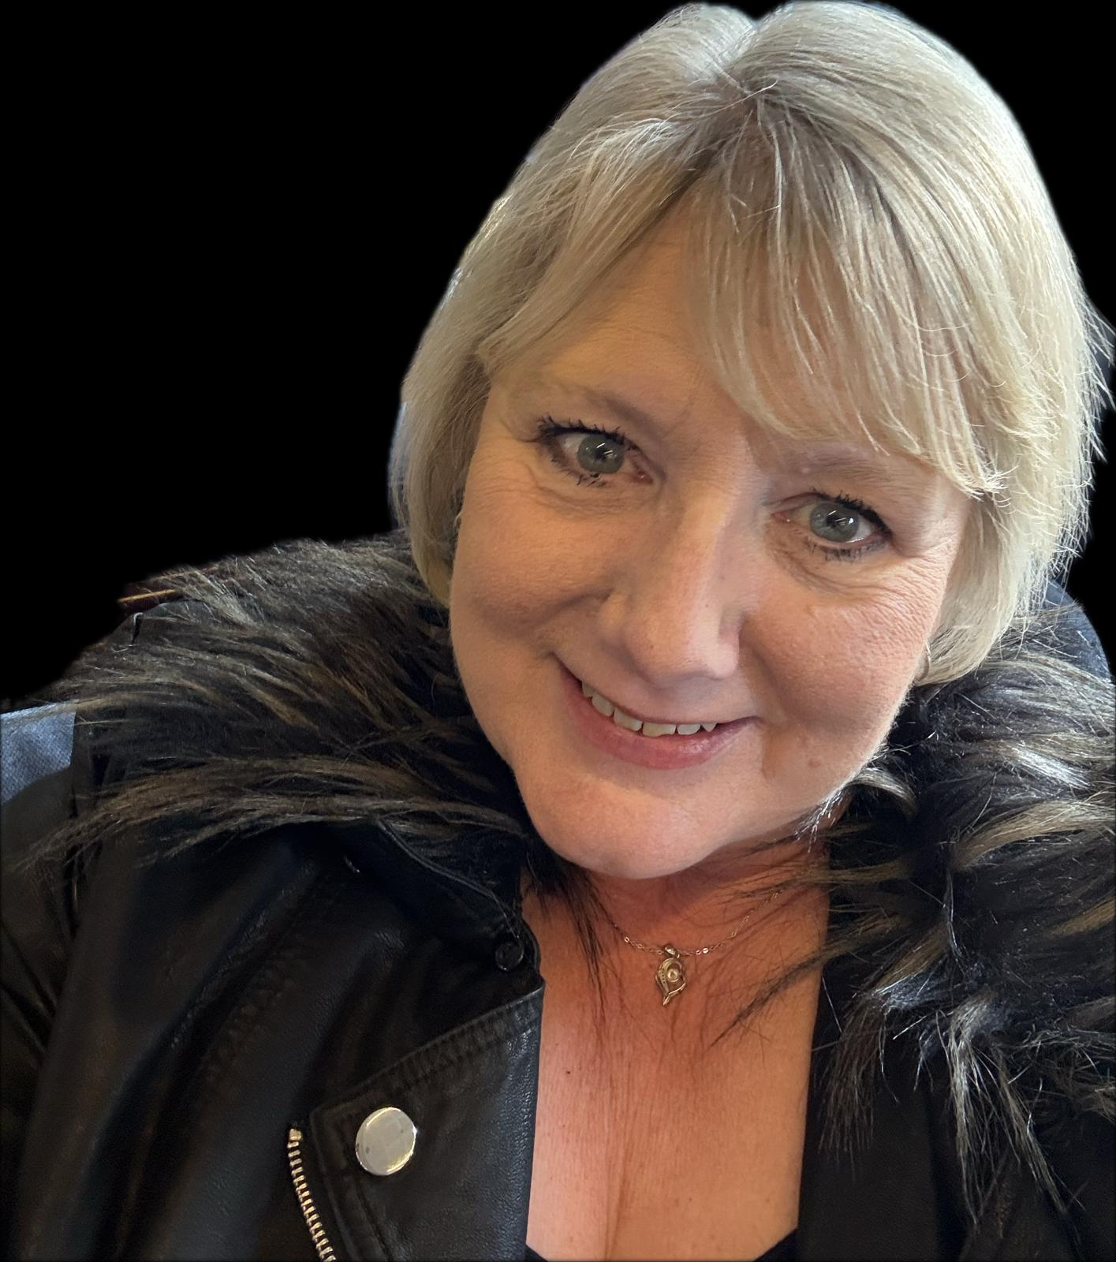
THH Safeguarding Officers
You’re not alone
Some of The Hope Hub Service Users have experienced past abuse or neglect. And support services may already be in place. For others, this might be the first time they have been abused or feel at risk of harm.
Our Safeguarding Officers are trained to assess risks, liaise with specialist services, and support you through concerns and disclosures of abuse.
In your role, you have a responsibility to respond and report concerns promptly to one of our Safeguarding Officers.
Camilla Spicer
The Head of Service Delivery
07543 429823 / 01276 581174 camilla.spicer@thehopehub.org.uk
Clare McCord
Day Services Manager
07543 429823 / 01276 743053 clare.mccord@thehopehub.org.uk
The Hope Hub - Registered charity in England and Wales number 1176452
Notes:
As a volunteer or member of staff you are unlikely to hold every piece of the jigsaw, but you may hold a very significant piece of the puzzle. Your role is to respond well and share/report the piece of the jigsaw that is disclosed to you with a suitable person and initially this means one of The Hope Hub Safeguarding Team.
Camilla Spicer, Head of Service Delivery 07543 429823 / 01276 581174 camilla.spicer@thehopehub.org.uk
Clare McCord, Day Services Manager 07543 429823 / 01276 743053 clare.mccord@thehopehub.org.uk
Gemma Johnston, Head of Grants/Fundraising and Marketing 07359 532731 / 01276 581174 gemma.Johnston@thehopehub.org.uk
Tristan Barrington-Waite, EAS Manager 07926 427235 / 01276 581174
Designated Leads for Safeguarding at The Hope Hub Mags Mercer, CEO and David Reed, Trustee

Slide 37
Confidentiality vs Risk of Harm
The Hope Hub has a Confidentiality Policy because mostly, conversations with Service Users are private.
However, where there is a safeguarding issue, such as a disclosure, allegation or concern about abuse, then it is the Head of Service Delivery, Camilla Spicer or the CEO, Mags Mercer who needs to assess the risk of harm and decide if immediate action is needed to safeguard the health or safety of the individual or anyone else who may be at risk.
If you hear an allegation or suspicion of abuse, immediately inform:
The Head of Service Delivery Camilla Spicer 07543 429823 / 01276 581174 camilla.spicer@thehopehub.org.uk
If you do not feel that your concerns are being addressed appropriately then tell:
The Chief Executive of THH Mags Mercer 07783 430092 /01276 581174 mags.mercer@thehopehub.org.uk
The Hope Hub - Registered charity in England and Wales number 1176452

Slide 38
A few questions on recognizing abuse are included in the quiz on completion of module 3:Responding to Abuse.
The Hope Hub - Registered charity in England and Wales number 1176452

Slide 39

for your time
The Hope Hub - Registered charity in England and Wales number 1176452
Notes:
Add to Reporting
Helplines –
Hourglass Helpline (older adults at risk of abuse): (wearehourglass.org) 0808
808 8141 https://wearehourglass.org/hourglass-services
Samaritans: Samaritans | Every life lost to suicide is a tragedy | Here to listen
116 123 https://www.samaritans.org
Thirtyoneeight: 03030031111 option 2 / (+44) 01322 517817
helpline@thirtyoneeight.org (THH is a member)

