Slide 1


Safeguarding
1. Your Role and Responsibility
The Hope Hub - Registered charity in England and Wales number 1176452
Notes:
Module 1 of THH Introduction to Safeguarding: Understanding your role and responsibility.
This is the first of three short modules that are an essential part of the induction processes for Volunteers and Staff at The Hope Hub.
Volunteers
At the end of the three modules, Volunteers will be asked to complete a short quiz. A score of 10/10 is necessary to complete the training and gain The Hope Hub Certificate: Introduction to safeguarding vulnerable adults for Volunteers.
Staff
At the end of the three modules, Staff will be required to complete a short quiz. A score of 15/15 is necessary to complete the training and gain The Hope Hub Certificate: Introduction to safeguarding vulnerable adults for Staff..

Slide 2
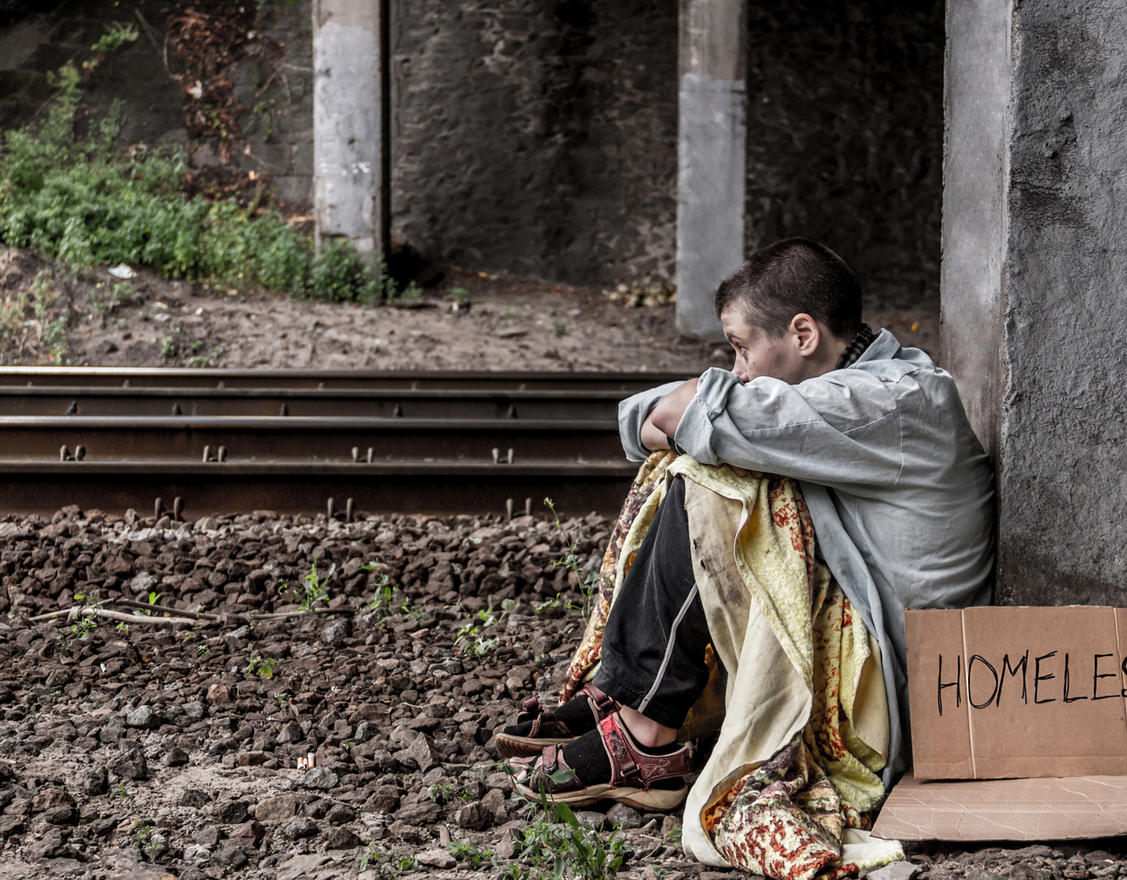
Safeguarding Vulnerable Adults at The Hope Hub
Key Policy 20
Safeguarding Vulnerable Adults Policy
The Hope Hub - Registered charity in England and Wales number 1176452
Notes:
The Hope Hub induction programmes for Volunteers and for Staff include a requirement to read through and commit to our policies.
This training module links with one key policy 20: Safeguarding Vulnerable Adults.
“Safeguarding is concerned with ensuring a person is free from harm, risk and danger, and that the individual can access the support they need to thrive and do well in life.” (Douglas and Fourie, 2022). It is a vital consideration at The Hope Hub where we aim to serve the needs of vulnerable adults, many of whom have a history of abuse, multiple traumas and highly complex needs.
.
The Hope Hub engage with a wide variety of local partners and professional bodies which helps us to keep up with legislative changes, guidance and best practice in safeguarding vulnerable adults. The Hope Hub is a member of Thirtyone:Eight, an independent organisation providing training and resources to safeguard children and vulnerable adults. These training modules have been reviewed in line with the Thirtyone:Eight Safeguarding Standards and Award.

Slide 3

Safeguarding at The Hope Hub
Induction Training
Your Role and Responsibility
Recognising Abuse
Responding to a Concern
The Hope Hub - Registered charity in England and Wales number 1176452
Notes:
Welcome to this first induction module in Safeguarding at The Hope Hub.
Safeguarding is everyone’s responsibility at The Hope Hub and consequently everyone needs a level of understanding about what this means in practice.
Volunteers, Staff, Designated Leads for Safeguarding and Trustees all undertake training in safeguarding that reflect their roles and responsibilities with vulnerable adults and the team at The Hope Hub.
Volunteers: Please focus on the slides – any information on the notes page is primarily aimed at staff and not included in your quiz.
Staff: Please scan the notes pages for any gaps in your knowledge. You will be expected to score 15/15 to achieve the THH Certificate Introduction to Safeguarding Vulnerable Adults and questions will be more challenging than those designed for the Volunteers.

Slide 4
Your Role in Safeguarding Others
Aims and Objectives
On completion of this training module, you should have a better understanding of:
  The key principles of safeguarding adults.
  The experiences that increase the vulnerability of adults.
  What safeguarding looks like for adults at The Hope Hub.
  Your role and responsibility in safeguarding others.
  Preventative safeguarding through good practice.
The Hope Hub - Registered charity in England and Wales number 1176452

Slide 5
Safeguarding Legislation
Defines Adult Safeguarding as:
  “Protecting an adult’s right to live in safety, free from abuse and neglect.
  It is about people and organisations working together to prevent and stop both the risks and experience of abuse or neglect,
  while at the same time making sure that the adult’s wellbeing is promoted
  including, where appropriate, having regard to their views, wishes, feelings and beliefs in deciding on any action.
  This must recognise that adults sometimes have complex interpersonal relationships and may be ambivalent, unclear or unrealistic about their personal circumstances.”
The Hope Hub - Registered charity in England and Wales number 1176452
Notes:
Safeguarding Legislation for Adults
The Care Act 2014 is the main law that informs safeguarding adults in England. The guidance that accompanies it defines adult safeguarding as:
“Protecting an adult’s right to live in safety, free from abuse and neglect. It is about people and organisations working together to prevent and stop both the risks and experience of abuse or neglect, while at the same time making sure that the adult’s wellbeing is promoted including, where appropriate, having regard to their views, wishes, feelings and beliefs in deciding on any action. This must recognise that adults sometimes have complex interpersonal relationships and may be ambivalent, unclear or unrealistic about their personal circumstances.”
This definition links closely with the the six key principles of safeguarding identified in the care Act 2014.
Legislation and accompanying guidance for England:
Care Act 2014 (legislation.gov.uk) - https://www.legislation.gov.uk/ukpga/2014/23/contents/enacted
Care Act factsheets - GOV.UK (www.gov.uk) - https://www.gov.uk/government/publications/care-act-2014-part-1-factsheets/care-act-factsheets
Care Act 2014 | SCIE - https://www.scie.org.uk/care-act-2014/
Mental Capacity Act 2005 (legislation.gov.uk) - https://www.legislation.gov.uk/ukpga/2005/9/contents

Slide 6
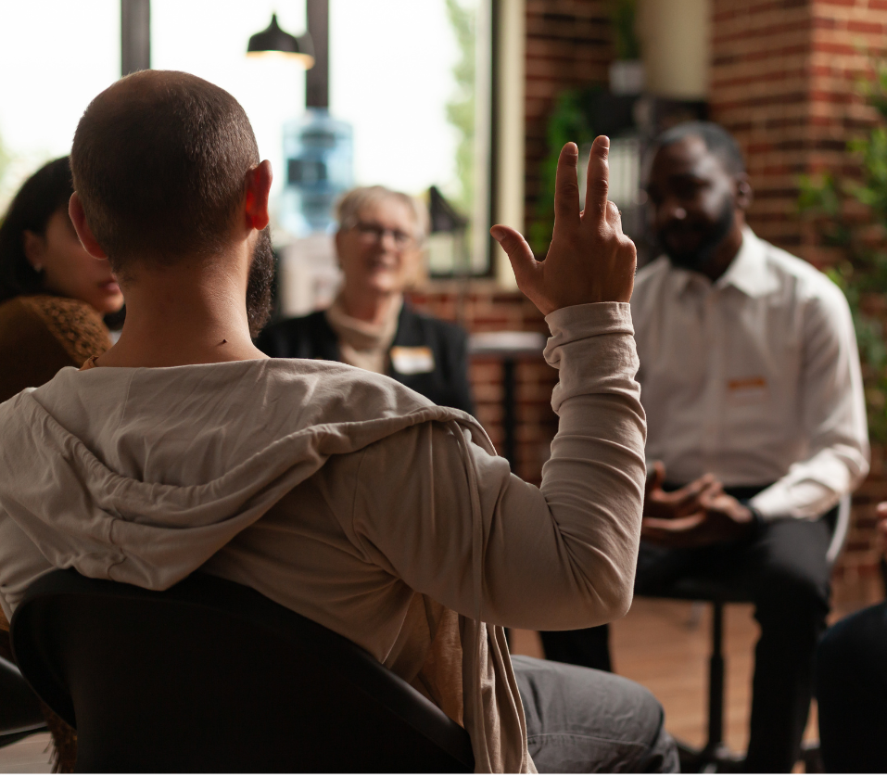
Safeguarding Principles
Care Act 2014
Empowerment
Prevention
Proportionality
Protection
Accountability
Partnership
The Hope Hub - Registered charity in England and Wales number 1176452
Notes:
Safeguarding principles
There are six key principles named in the Care Act that underpin our approach to safeguarding adults at The Hope Hub:
Empowerment: We support and encourage adults to make their own choices and give informed consent to any safeguarding measures.
Prevention: We act before harm occurs.
Proportionality: We only get involved as much as we are needed, and any action taken is the least intrusive response appropriate to the situation.
Protection: We act to support and protect those in greatest need.
Partnership: We work with other agencies to prevent, detect and report neglect and abuse.
Accountability: We are accountable and transparent in our safeguarding work.
The safeguarding leads, trustees and officers at The Hope Hub have undertaken additional training to help everyone know how to follow these principles and embed them in our policies and practices. They also have insight into ‘the bigger picture’ of circumstances, complex needs and ongoing support for each Service User who attends THH, along with extensive experience in assessing risks to the SU, to Volunteers, Staff and others.
So, you are not alone in safeguarding adults at The Hope Hub, but you are responsible for playing your part effectively, and our series of training modules in Safeguarding will help you know how to do so.

Slide 7
Safeguarding at The Hope Hub
The Hope Hub Ethos
H Holistic
O Open to all
P Person centred
E Empowering
The Hope Hub - Registered charity in England and Wales number 1176452
Notes:
Safeguarding at The Hope Hub
The charitable aims of The Hope Hub are to provide HOPE through a
H = Holistic range of services by qualified and trained staff and volunteers
O = Open access for all who need our services within the Borough and surrounding areas
P = Person Centred with a strengths-based (trauma informed) approach, working with each person
E = Empowering each person to move towards independent living
The charity strives to achieve these aims by providing a SERVICES PATHWAY comprising Crisis Support and Empowerment Services including Outreach and a 7 bedroom Emergency Accommodation Service (EAS).
Our role is to balance providing a warm welcome, practical support and care for all who are at risk of homelessness or poverty with a recognition that we have a duty to protect the vulnerable.
We must also be aware of the sad reality that those who wish to perpetrate abuse may even target The Hope Hub as a place with easy access to potential victims.
Many of our Service Users are Vulnerable Adults. So let’s unpack what we, and the Law in England, regard as being a Vulnerable Adult.
Signposting and Useful Links
THH Annual Reviews
Charity Commission Registration of THH

Slide 8
Safeguarding Vulnerable Adults
At The Hope Hub
Service Users
at The Hope Hub
Over 18 yrs | Homeless | At risk of being Homeless | Mental Health Illness | Addiction | Domestic Violence | Learning Difficulties | Disabilities | Physically abused | Child-Sexual Exploitation | Ex-offenders | Ex-military | Post-traumatic stress | Refugees | Asylum Seekers | Spoken English is an Additional Language …..
Vulnerable Adult
Has care and support needs
Is experiencing, or is at risk of, abuse or neglect
Is unable to protect themselves from abuse or neglect
.
The Hope Hub - Registered charity in England and Wales number 1176452
Notes:
Safeguarding Vulnerable Adults in England
The Care Act 2014 states that adult safeguarding duties apply to anyone aged 18 or over who meets all three of the following conditions:
Has care and support needs (whether or not the Local Authority is meeting those needs) = All at THH
Is experiencing, or is at risk of, abuse or neglect – High proportion of current neglect, past and possibly current abuse.
Is unable (or less able) to protect themselves from abuse or neglect because of their care and support needs. – Our Safeguarding Team will/should know this if staff and volunteers feed through information in suitable formats
Consider the range of Service Users supported by THH and reflect on the proportion of them that would be considered Vulnerable or At Risk.
Signposting and Useful Links
THH Policies linked with Safeguarding – Refer to slide 16 Safeguarding: Related Policies
Other Relevant Legislation
Serious Crime Act 2015 Protection of Freedoms Act 2012
Equality Act 2010 Safeguarding Vulnerable Groups Act 2006
Sexual Offences Act 2003 Crime and Disorder Act 1998
Mental Health Act 1983 Police and Criminal Evidence Act 1984

Slide 9
Safeguarding Vulnerable Adults
Your Role in Safeguarding at The Hope Hub
Know the Safeguarding Team
Know who to share and who not to share concerns with at The Hope Hub.
Support, Training, Protection
Read the safeguarding policies | Complete induction training for your role | Attend volunteer forums | Know how to protect yourself and others
Voice Concerns
Know how to recognise, respond, record and report concerns quickly to the right person.
Safe and Caring Environment
Help to provide a safe and caring environment for Service Users | Be Trauma Aware | Use the posters, leaflets and Case workers to signpost SUs to further community initiatives.
Uphold Human Rights
There is no place for abuse, discrimination, bullying, exploitation, lies, or disrespect at The Hope Hub.
The Hope Hub - Registered charity in England and Wales number 1176452
Notes:
How an organisation responds when concerns of harm or abuse are raised is important in ensuring vulnerable people are protected and supported and that justice may be done. At THH many of Service Users are Vulnerable and at risk of harm. Many of them are also short or long-term ‘victim survivors’ of abuse &/or neglect. This is why THH follows a ‘Trauma Informed, Strength-Based Approach’ across all our activities, including Safeguarding.
Today we focus on a broad overview of your role and responsibility in safeguarding others. This includes:
Knowing who is on the Safeguarding team at THH and has higher level skills.
Completing your induction training including reading the THH policies.
Your duty to voice any concerns effectively, while respecting confidentiality.
Providing SUs with a safe and caring space at all times; being Trauma Aware
An overview of the Human Rights we must uphold.
This module introduces each of these responsibilities.
Further training modules provide more information on
How to recognise abuse and neglect
How to respond, record and report concerns appropriately
Victim Survivors – being Trauma Aware
Trauma Informed Practice – Including Every Interaction Matters
Your observations and response may be the vital link in setting someone free from abuse and preventing abuse from happening to others, so it is important that we feel confident in these areas.

Slide 10
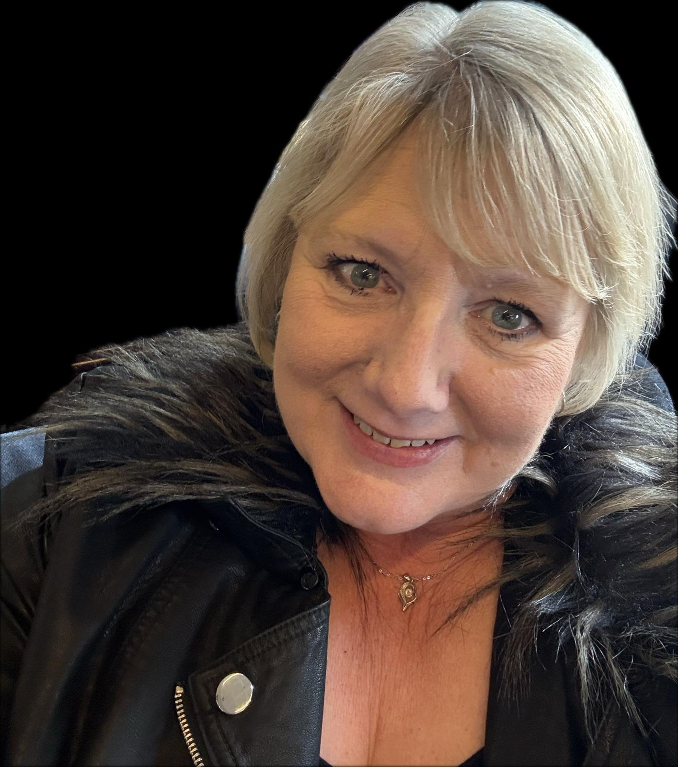
THH Safeguarding Officers
Know Who to Talk To
Camilla Spicer
The Head of Service Delivery
07543 429823 / 01276 581174 camilla.spicer@thehopehub.org.uk
Clare McCord
Day Services Manager
07543 429823 / 01276 743053 clare.mccord@thehopehub.org.uk
Our Safeguarding Officers are trained to assess risks, liaise with specialist services, and support you. They know how to follow the principles, legislation and guidance to safeguard vulnerable adults.
The Hope Hub - Registered charity in England and Wales number 1176452
Notes:
Some of The Hope Hub Service Users can be very vocal in sharing their life stories with relative strangers in the Crisis Area, around the meal table at the EAS or during other THH activities. Generally, our Head of Service Delivery (Camilla), the Day Service Manager (Clare), and Tristan over at the EAS know the Service Users’ background, the partner support services they engage with and longer-term goals for their empowerment.
As a volunteer or member of staff you are unlikely to hold every piece of the jigsaw, but you may hold a very significant piece of the puzzle that no-one else can see. Your role is to respond well and report the piece of the jigsaw that is disclosed to you with a suitable person and initially this means one of The Hope Hub Safeguarding Team.
Our Safeguarding Officers are trained to assess risks, liaise with specialist services, and support you. They know how to follow the principles, legislation and guidance to safeguard vulnerable adults.
Their pictures and contact details are on display around The Hope Hub. Check that you know who they are.
Signposting and Useful Links – Next slide

Slide 11
Confidentiality vs Risk of Harm
Respect Confidentiality across THH
The Hope Hub has a Confidentiality Policy because mostly, conversations with Service Users are private.
However, where there is a safeguarding issue, such as a disclosure, allegation or concern about abuse, then it is the Head of Service Delivery, Camilla Spicer or the CEO, Mags Mercer who needs to assess the risk of harm and decide if immediate action is needed to safeguard the health or safety of the individual or anyone else who may be at risk.
If you hear an allegation or suspicion of abuse, immediately inform:
The Head of Service Delivery Camilla Spicer 07543 429823 / 01276 581174 camilla.spicer@thehopehub.org.uk
If you do not feel that your concerns are being addressed appropriately then tell:
The Chief Executive of THH Mags Mercer 07783 430092 /01276 581174 mags.mercer@thehopehub.org.uk
The Hope Hub - Registered charity in England and Wales number 1176452
Notes:
The Hope Hub has a Confidentiality Policy because mostly, conversations with Service Users are private and personal information should not be shared with other Service Users. (Volunteers/Staff). However, where there is a safeguarding issue, such as a disclosure, allegation or concern about abuse, then it is important to share it immediately with one of the Safeguarding team:
Camilla Spicer, Head of Service Delivery 07543 429823 / 01276 581174 camilla.spicer@thehopehub.org.uk
Clare McCord, Day Services Manager 07543 429823 / 01276 743053 clare.mccord@thehopehub.org.uk
Gemma Johnston, Head of Grants/Fundraising and Marketing 07359 532731 / 01276 581174 gemma.Johnston@thehopehub.org.uk
Tristan Barrington-Waite, EAS Manager 07926 427235 / 01276 581174
Designated Lead for Safeguarding at The Hope Hub Mags Mercer, CEO and David Reed, Safeguarding Trustee
The Head of Service Delivery, Camilla Spicer or the CEO, Mags Mercer need to assess the risk of harm and decide if immediate action is needed to safeguard the health or safety of the individual or anyone else who may be at risk.

Slide 12
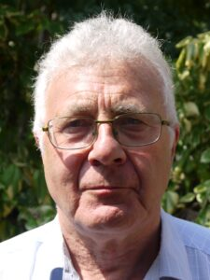
THH Safeguarding Leads
Risk Assessment and Escalation
The Safeguarding Leads at The Hope Hub have many years of experience and training in safeguarding. They are swift to assess risks and know how to meet legislation. They are quick to implement further support at The Hope Hub and secure external specialist support and guidance.
If you do not feel that your concerns are being addressed appropriately then speak to Mags or David.
Mags Mercer
The Chief Executive of THH
07783 430092 /01276 581174 mags.mercer@thehopehub.org.uk
David Reed
Lead Trustee for Safeguarding
Tel:07789 848 891
Email: davidjreed67@gmail.com
The Hope Hub - Registered charity in England and Wales number 1176452
Notes:
Designated Leads for Safeguarding at The Hope Hub Mags Mercer, CEO and David Reed, Safeguarding Trustee
The Safeguarding Leads at The Hope Hub have many years of experience and training in safeguarding. They are swift to assess risks and know how to meet legislation. They are quick to implement further support at The Hope Hub and secure external specialist support and guidance.
If you do not feel that your concerns are being addressed appropriately then speak to Mags or David.
Signposting and Useful Links
Designated Lead for Safeguarding at The Hope Hub
Mags Mercer, CEO
David Reed, Safeguarding Trustee

Slide 13

Safeguarding at The Hope Hub
Partnerships
Emergency Services
Safeguarding Lead and Officers
Adult Social Care Services
Multi-Agency Hubs (MASH)
Police
Safeguarding Adults Board (SAB)
The Hope Hub - Registered charity in England and Wales number 1176452
Notes:
Emergency Services: If there is a risk to life, someone is at risk of serious harm or a serious crime has been committed, we need to call 999 so emergency services can respond quickly…. And then inform the Safeguarding team.
Safeguarding Lead: Every organisation should have a safeguarding lead, although they might have a different title – such as safeguarding co-ordinator, designated officer, safeguarding advisor etc. The safeguarding officers/lead are your first port of call for any concerns within your organisation. They keep records and liaise with statutory agencies when necessary.
Signposting and Useful Links
Adult Social Care Services: This is the government-funded (statutory) agency for providing services to adults with care and support needs through the Local Authority. Link to contact details including for out of hours / emergency situations.
Multi Agency Safeguarding Hubs (MASH): These are teams made up of highly skilled professionals from different agencies including social work, police, health, and education. Link.
Police: The police service may be part of a safeguarding response when a crime has been committed, whether or not they have been part of an emergency response.
Safeguarding Adults Board (SAB): These strategic boards are responsible for overseeing local safeguarding arrangements, support and effective service delivery.
The Safeguarding Team at The Hope Hub work with all these agencies on a regular basis.

Slide 14

Safeguarding at The Hope Hub
Strength Based Approach
Considers ‘What is strong’ rather than simply ‘What is wrong’.
Values an individual’s strengths - their skills, abilities, knowledge, connections, experience, potential and other assets.
Supports the key principles of safeguarding adults at risk.
The Hope Hub - Registered charity in England and Wales number 1176452
Notes:
The Care Act 2014 puts a strengths-based approach at the centre of someone’s assessment, care and support, highlighting ‘What is strong’ rather than simply ‘What is wrong’. This means that strengths and talents are identified so that things that are important to people are taken into account. This will help to promote individual wellbeing.
A Strengths Based Approach to assessment and practice means valuing an individual’s strengths- their skills, abilities, knowledge, connections, experience, potential and other assets. These are the starting points for planning any care and support, for example, rather than the first focus being on what they cannot do or are struggling with (although these things mustn’t be ignored).
It means that the organisation providing support or services works collaboratively with the individuals accessing the support or service to find the best way to enable each person to achieve desired outcomes. It works alongside a person-centred, rights-based approach to safeguarding as it values the adult at risk as an individual human being and looks to find safeguarding measures that reflect that person’s life and choices.

Slide 15

Safeguarding at The Hope Hub
Strength Based Approach
Strengths, needs and personal outcomes.
Case Study / Example /Story
Or video: You Tube https://www.scie.org.uk/strengths-based-approaches/videos/
The Hope Hub - Registered charity in England and Wales number 1176452
Notes:
“A strengths-based approach to care, support and inclusion says let’s look first at what people can do with their skills and their resources and what can the people around them do in their relationships and their communities. People need to be seen as more than just their care needs – they need to be experts and in charge of their own lives.” - Alex Fox, chief executive of the charity Shared Lives
A Strengths-Based Approach supports the key principles of safeguarding adults at risk that are laid out in national policies and legislation.
Signposting and Useful Links
Good 8 min video for Volunteer Forum/ Induction on You Tube: https://www.scie.org.uk/strengths-based-approaches/videos/
England: Strengths-based approaches - Care Act guidance | SCIE - https://www.scie.org.uk/strengths-based-approaches/guidance/#whatis

Slide 16

Safeguarding at The Hope Hub
Trauma Informed Approach
When we are trauma aware, our approach moves from ‘What’s wrong with you?’ to ‘What do you need? What happened to you? What is your behaviour telling me?’
When we listen well and become aware of the impact of trauma, we can then seek to build safe and trusted environments where we can better support those who have experienced trauma and avoid creating situations where someone might be retraumatised.
The Hope Hub - Registered charity in England and Wales number 1176452
Notes:
Trauma Awareness
Trauma describes a situation or response to a situation in which a person felt unsafe. What's traumatic is personal. A person might have similar experiences to someone else but be affected differently. Trauma can affect a person’s biological, psychological and social development. We might notice the effects of trauma in someone’s behaviour and responses to situations.
Survivor voice: “I wish there was more awareness of trauma and the way it affects a person's thought process and behaviour. [...] Self-preservation behaviours can be greatly misinterpreted or misunderstood.” (from What is trauma? - Mind) https://www.mind.org.uk/information-support/types-of-mental-health-problems/trauma/about-trauma/
Many people involved in safeguarding, and working with vulnerable groups in any capacity, are seeking to become more trauma aware. When we are trauma aware, our approach moves from ‘What’s wrong with you?’ to ‘What do you need? What happened to you? What is your behaviour telling me?’
When we listen well and become aware of the impact of trauma, we can then seek to build safe and trusted environments where we can better support those who have experienced trauma and avoid creating situations where someone who might be retraumatised.
Working definition of trauma-informed practice - GOV.UK (www.gov.uk) - https://www.gov.uk/government/publications/working-definition-of-trauma-informed-practice/working-definition-of-trauma-informed-practice

Slide 17

Safeguarding at The Hope Hub
Trauma Informed Approach
Case Study / Example /Story
Or video: You Tube (US but applicable) https://www.youtube.com/watch?v=fWken5DsJcw
The Hope Hub - Registered charity in England and Wales number 1176452
Notes:
Trauma Awareness
In the UK, there has been a movement in recent years to develop ‘trauma-informed practice’ in services that support vulnerable groups. This involves specialist training for professionals and key principles being written into guidance. In terms of safeguarding, this means equipping professionals with a greater understanding that some behaviours may have a basis in trauma and delivering services in a way that promotes a feeling of safety and empowerment:
“Trauma informed practice is not intended to treat trauma-related issues. It seeks to reduce the barriers to service access for individuals affected by
trauma, and to promote understanding of the impact of trauma on individuals.” From Trauma - Adult Support and Protection (Scotland) Act 2007:
guidance for General Practice - gov.scot (www.gov.scot)
Signposting and Useful Links
What is trauma? – Mind - https://www.mind.org.uk/information-support/types-of-mental-health-problems/trauma/about-trauma/
UK Trauma Council (focus on supporting children and young people) - https://uktraumacouncil.org
Trauma | Mental Health Foundation - https://www.mentalhealth.org.uk/explore-mental-health/a-z-topics/trauma
Trauma-informed practice: toolkit - gov.scot (www.gov.scot) - https://www.gov.scot/publications/trauma-informed-practice-toolkit-scotland/pages/4/
What is Trauma Informed Practice? (safeguardingni.org) - https://www.safeguardingni.org/trauma-informed-approaches/what-does-trauma-informed-mean

Slide 18
Safeguarding Vulnerable Adults
Upholding Human Rights
1. The obligation to respect human rights.
2. The right to live.
3. Freedom from torture.
4. Freedom from slavery and forced labour.
5. The right to liberty and security
6. The right to a fair trial
7. No punishment without law
The Hope Hub - Registered charity in England and Wales number 1176452
Notes:
Human Rights
Keeping the adult at the centre of their own life, care, decisions and processes is a key principle for safeguarding legislation and policy in all 4 nations of the UK. One of the main concepts that informs this principle is that of ‘human rights’ – the basic rights and freedoms that we all have. They apply to every person in the world, from birth until death, regardless of where you are from, what you believe or how you choose to live your life. They are based on values like dignity, respect, fairness and equality. In the UK, these are written into law in the Human Rights Act 1998, based on the European Convention of Human Rights (ECHR).
The Human Rights Act means that public bodies have to ensure that none of their practices contravene an individual’s human rights. This includes police, local authorities, courts, prisons and the NHS. (Individuals and private companies aren’t bound by this law.) The governments of each UK nation will also look to make any new laws and national policies compatible with the Human Rights set out in this legislation.
The Human Rights Act sets out each right in a different ‘Article’: *Articles 1 and 13 are from the ECHR, not the Human Rights Act 1998 as the Act itself is the way that the UK fulfils these articles. Our human rights can’t be taken away, but some can be restricted in certain circumstances. For example, if a person breaks the law and is given a prison sentence, their right to liberty can be limited.

Slide 19
Safeguarding Vulnerable Adults
Upholding Human Rights
8. The right to respect for private and family life.
9. Freedom of thought, belief, and religion.
10. Freedom of expression.
11. Freedom of assembly and association.
12. Right to marry and start a family.
13. Right to an effective remedy through courts of other public body.
14. Protection from discrimination.
The Hope Hub - Registered charity in England and Wales number 1176452
Notes:
Human Rights
The Human Rights Act sets out each right in a different ‘Article’: *Articles 1 and 13 are from the ECHR, not the Human Rights Act 1998 as the Act itself is the way that the UK fulfils these articles. Our human rights can’t be taken away, but some can be restricted in certain circumstances. For example, if a person breaks the law and is given a prison sentence, their right to liberty can be limited.
When we talk about a ‘rights-based’ approach to safeguarding adults at risk, it means ensuring that any safeguarding measures, processes and practices don’t contravene their human rights. It also encourages us to remember that every individual is a human being with these rights and freedoms. We don’t want to limit them in the interests of ‘safety’ if there are less restrictive options available, even if these options are more complicated or difficult.
Signposting and Useful Links
Homepage | EHRC (equalityhumanrights.com) - https://www.equalityhumanrights.com
About the Human Rights Act – Mind - https://www.mind.org.uk/information-support/legal-rights/
What rights are protected under the Human Rights Act? - Citizens Advice - https://www.citizensadvice.org.uk/law-and-courts/civil-rights/human-rights/what-rights-are-protected-under-the-human-rights-act/

Slide 20

Safeguarding at The Hope Hub
Disability Confident Employer
The Hope Hub maintains the status of
being a Disability Confident Employer,
promoting and supporting diversity
and inclusion across the charity. This
includes meeting the key principles of
Disability-Inclusive Safeguarding.
The Hope Hub - Registered charity in England and Wales number 1176452
Notes:
Promoting and supporting diversity and inclusion in the workplace is an important aspect of good people management – it’s about valuing everyone in the organisation as an individual and recognising that each person has a unique set of skills, experiences and perspectives. To reap the benefits of a diverse workforce it’s vital to have an inclusive environment where everyone feels able to participate and achieve their potential.
Key Principles of Disability-Inclusive Safeguarding
Promoting Human Rights: Safeguarding must uphold the rights to fairness, respect, participation, and autonomy in decision-making for people with disabilities.
Inclusion in Communities: Safeguarding ensures people with disabilities are included in communities, rather than excluded, and can live the life they choose.
Empowering Individuals: People should be supported to understand their rights, recognize risks of abuse, and know who to tell when something is wrong.
Accessible Communication and Reporting: Systems and processes for safeguarding must be adapted to ensure accessibility for people with various types of disabilities, including auditory and visual aids and accessible language.

Slide 21
Safeguarding: Related Policies
These are all summarised in the Volunteer Handbook
Paper copies are in a file on the Volunteer Station
Child Protection
THH services are for 18yrs+ No children on site.
Drug, Alcohol & Substance Misuse Workplace
None allowed on site. Some SUs supported on withdrawal.
Acceptable Service User Behaviour
House Rules are up on the wall. Call staff to reinforce.
Bullying / Whistle blowing
Concerns about malpractice – impact on innocent individuals.
Serious / Untoward Incident
Unexpected event, putting you or others at risk.
The Hope Hub - Registered charity in England and Wales number 1176452
Notes:
Our CEO and trustees review and update all THH policies annually or earlier if legislation and guidance changes.
The above polices also relate to safeguarding vulnerable adults. They are available to Volunteers and Staff in paper format at each location, at all times, and everyone is asked to refresh their knowledge and agreement with the policies annually.

Slide 22

Preventative Safeguarding
Questions to Ask Yourself
Do you have a clear understanding of the expectations and boundaries of your role and how we work safely?
How well do you know The Hope Hub policies, procedures and codes of conduct as these are important sources of information about safeguarding at THH?
Do you know the word to shout out to call staff to support you if there is an incident?
The Hope Hub - Registered charity in England and Wales number 1176452
Notes:
As well as using the 5 ‘R’s to ensure we have a robust safeguarding process (next slide), THH also have a responsibility to prevent harm occurring to adults at risk through their interaction with us. We have a duty to safeguard our staff and volunteers as they outwork their roles.
Overall responsibility for complying with legislation and Charity Regulator expectations for safeguarding lies with the trustees of an organisation, but safeguarding is everyone’s responsibility, and we all have a part to play. We need to have a clear understanding of the expectations and boundaries of our role and how we work safely.
The Hope Hub policies, procedures and codes of conduct are important sources of information about this, so please take time to find and read them. If you have any questions or uncertainties, talk with one of the safeguarding team to see how the policies apply in your particular context.
We also have a ‘watchword’ to call out if an incident arises. This code word alerts staff and volunteers in the area to come to your aid and help to defuse or de-escalate a situation or provide emergency support. Never try to manage an incident or challenging SU on your own. You should also never leave the building before an incident has been reported, and you have talked it through enough to leave any discomfort at THH enabling you to go home unburdened.

Slide 23
Preventative Safeguarding
Further Questions to Ask Yourself – see notes
Re Lone working
Risk assessments
Physical contact
Handling money
Sharing contact details
Mentoring and support
Feeling safe
Your ideas for improvements
The Hope Hub - Registered charity in England and Wales number 1176452
Notes:
Here are some questions to consider:
• What is the guidance around lone working? Do you work on a one-to-one basis with adults at risk? If so, what safeguards and accountability measures are in place to keep everyone safe?
• Are risk assessments undertaken, shared and reviewed for activities that involve adults at risk?
• What is the guidance around physical contact for different activities? For example, cooking and serving meals, storing food, delivering goods, prayer ministry, hospital visiting, providing transport.
• What is the guidance around handling money or fundraising when it comes to adults at risk? Is handling money part of your role or not?
• What is the guidance around sharing personal contact details? What about online contact, social media etc.?
• Do you have regular contact with someone for support related to your role – a team leader or mentor, for example?
• What would you do if you felt unsafe or uncomfortable at any time while outworking your role?
• Have you got any ideas that would contribute to building a healthier safeguarding culture in your organisation? If so, share them!
Signposting and Useful Links
Links to answers to the above questions???

Slide 24
Your Role in Safeguarding Others
Aims and Objectives
Recap:
On completion of this training module you should have a better understanding of:
  The key principles of safeguarding adults.
  The experiences that increase the vulnerability of adults.
  What safeguarding looks like for adults at The Hope Hub.
  Your role and responsibility in safeguarding others.
  Preventative safeguarding through good practice.
The Hope Hub - Registered charity in England and Wales number 1176452
Notes:
Everyone must take responsibility for safeguarding.
Think of your observations being an important or missing piece in complex jigsaw puzzle. You may not see the whole picture but with your information others may be able to prevent further harm or abuse.
In your role, you have a responsibility to respond and report concerns promptly to one of our Safeguarding Officers. Our next modules unpick what we mean by this.

Slide 25
Safeguarding at The Hope Hub
Recognising Concerns
Recognise
Respond
Record
Report
Reflect
These five steps can be a helpful way to guide us through the process and responsibilities of responding well to safeguarding concerns, allegations or disclosures.
In our second module on Safeguarding, we focus on different types of abuse and how to recognise indications that someone is at risk or being abused or harmed.
The Hope Hub - Registered charity in England and Wales number 1176452
Notes:
The following two modules provide you with more information about how to recognise and respond well to and safeguarding concerns, but please first answer the questions below to complete this module.

Slide 26

for your time
The Hope Hub - Registered charity in England and Wales number 1176452

