Slide 1


Volunteer Forum
16th October 2025
The Hope Hub - Registered charity in England and Wales number 1176452

Slide 2
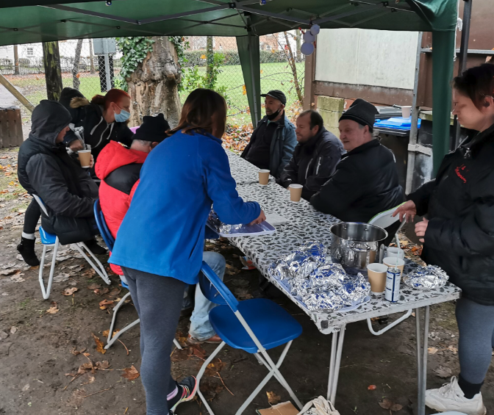

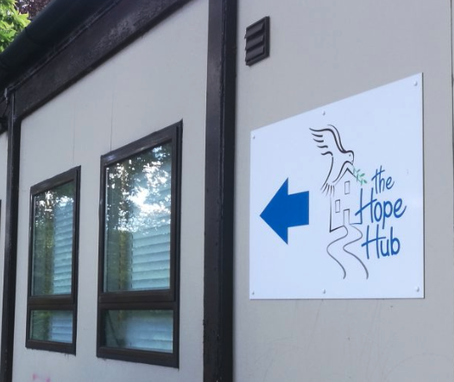
Agenda
H = Holistic
O = Open to all
P = Person centred
E = Empowering
Welcome & Update - Mags
Kitchen Update
Goodbyes and Hellos
Safeguarding Award
Safeguarding - Your Role and Responsibilities
Harvest Update
Any other questions.
The Hope Hub - Registered charity in England and Wales number 1176452

Slide 3
Welcome
Busy Autumn term
Goodbyes and Hellos
Awards & Ratings
Impact
The Hope Hub
‘For the Relief of Poverty’
Working to prevent & End Homelessness in our Community
Mags Mercer
Chief Executive
Mags.Mercer@thehopehub.org.uk
Mb: 07783 430092

Slide 4



‘For the Relief of Poverty’
Working to prevent & END Homelessness in our Community
The Hope Hub - YouTube
Mags Mercer Chief Executive
mags.mercer@thehopehub.org.uk | 07783 430092 www.thehopehub.org.uk
Registered Charity No. 1176452
H = HOLISTIC
O = OPEN TO ALL
P = PERSON CENTRED E = EMPOWERING
The Hope Hub - Registered charity number 1176452

Slide 5
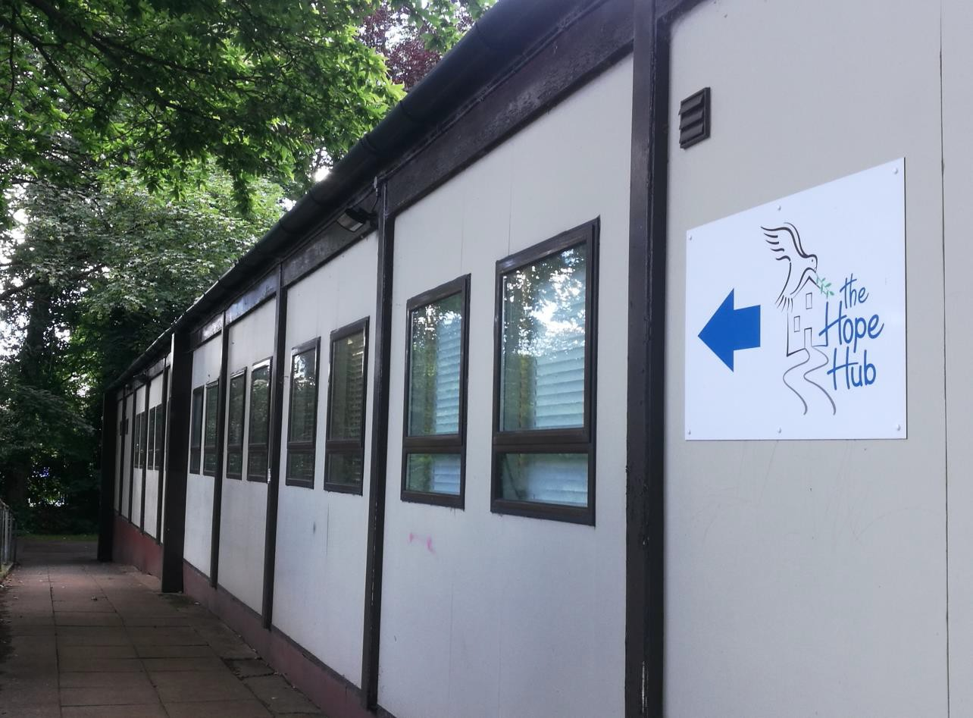
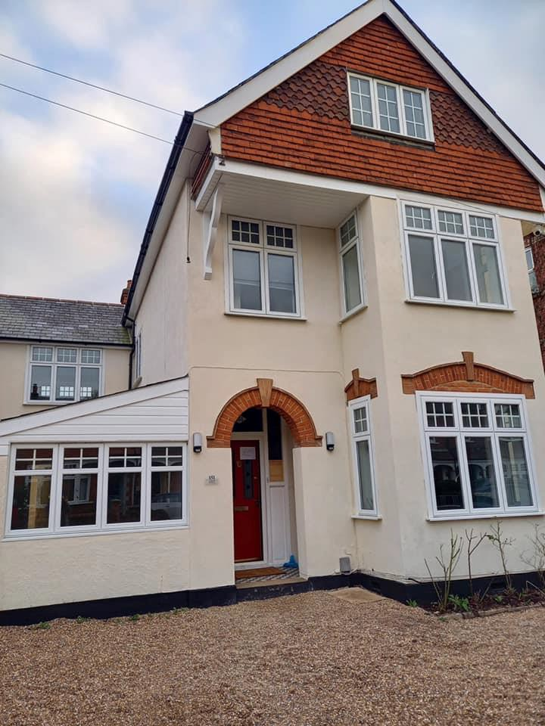
THH DAY SERVICE & EMERGENCY ACCOMMODATION HOUSE (EAS)
SERVICES PATHWAY : CRISIS & EMPOWERMENT
The Hope Hub - Registered charity number 1176452

Slide 6

Services Pathway Includes
Crisis Drop In – shower, meals, laundry, emergency items
Empowerment Services – housing, UC etc
Energy Advice
Living Well Workshops – Day Service, EAS & Community
Warm Welcome Space (Nov-Mar)
Weekly Outreach Drop In at
Old Dean
Outreach rough sleepers across the Borough
Digital Workshops
CV, Tng &
Job Support
1/11 Partners
18-30 Wellbeing & Suicide Prevention
1/11 Partners
1/11 Partners
The Hope Hub - Registered charity number 1176452

Slide 7
Period : April 2024 – September 2025
196 People supported. 164 MH &/or SM 70
45/72 NFA successfully housed. Additional 25 S/Surfing.
6,367 Services Accessed : 33 times each
331 Outreach support - Boroughwide – vulnerable / homeless
1,508 Visits to THH Day Services
3,174 Meals & Refreshments (1 time count)
407 Food Parcels
132 Employment Support/CV support
40 Attended Training. Some attaining L1 or L2 qualifications
124 Living Well Workshops / Activities.
➢ 183 Debt Management support.
➢ 11 Secured employment.
H = HOLISTIC
O = OPEN TO ALL
P = PERSON CENTRED
E = EMPOWERING
The Hope Hub - Registered charity in England and Wales number 1176452

Slide 8
Other Services
Warm Hub : November ’25-March ’26 : Tues, Wed, Fri
Meal, Activities, Fuel Vouchers & Training
Circa 50 people attended Cooking Workshops - Community
Creative Therapy Workshops
Old Dean Weekly ‘Outreach Service’ – since Jan 2024
Achieved a ‘5 Star Food Hygiene Rating’ (2nd time)
Awarded: IiV UK Quality Standard : Investing in Volunteers
H = HOLISTIC
O = OPEN TO ALL
P = PERSON CENTRED
E = EMPOWERING
The Hope Hub - Registered charity in England and Wales number 1176452

Slide 9
Police Commission
The Commissioner said:
“It is difficult to overstate how proud I am to supporting organisations like The Hope Hub".
“Without fanfare, staff and volunteers are changing the lives of some of our most vulnerable residents for the better'.
“This tireless work means that, even when a person has complex needs or a challenging background, they don’t fall through the gaps between services'.
“Almost 50 per cent of the Hub’s clients are ex-offenders who need support to re-enter the workforce. These are people who, with help, can stay out of the criminal justice system for good'.
Notes:
27,000 meals - and a sanctuary for those without a home of their own
In an unassuming portacabin near a Surrey Heath library, a team of staff and volunteers are improving the lives of the borough's homeless residents.
The Hope Hub, based in Camberley, has served up 27,000 hot meals since 2019. The service aims to support veterans and rough sleepers into work and safe accommodation.
One client, a pensioner found sleeping in a van, was helped to secure ID, open a bank account, access his pension, and find a property.
The Hub is part-funded by Surrey’s Police and Crime Commissioner Lisa Townsend, who recently approved a new grant from her Reducing Reoffending Fund to support the service until 2028.
Staff offer both practical and pastoral support, including the use of washing machines, dryers and warm showers, as well as training courses and money management classes.
More here >

Slide 10

Well Done Everyone
Inspection Results
Excellent. Congratulations
Storeroom – Good Stock Rotation and Store
Fridge Life – Please use the plastic containers provided to store food and date when opened and when it should be used by. Eg cheese should be used within a week of opening.
Handwashing Sink – As we now supply so many meals, we need another sink.
‘We love the Cooks WhatsApp Group’……Well done Sian, David and all the extra help this Christmas

Slide 11

Kitchen Update
Plans, funding and corporate support to upgrade the kitchen are well underway.
We will let you know when work is scheduled to begin and trust you will forgive any inconvenience.
‘We love the Cooks WhatsApp Group’……Well done Sian, David and all the extra help this Christmas

Slide 12
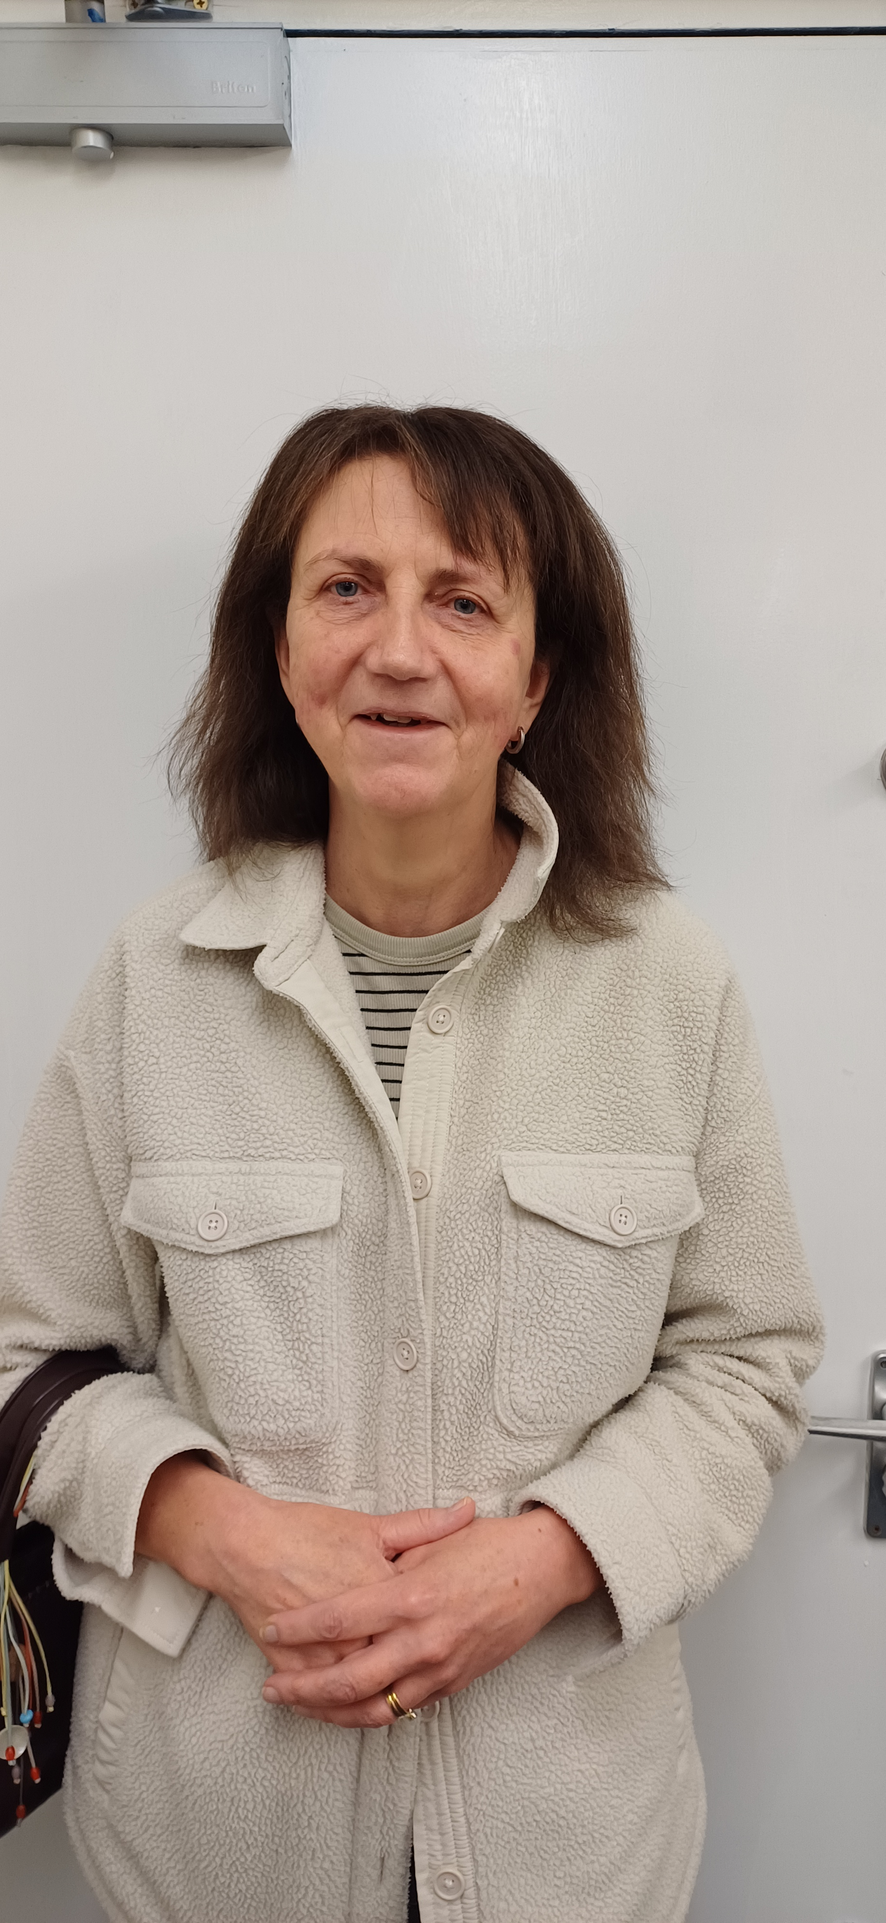
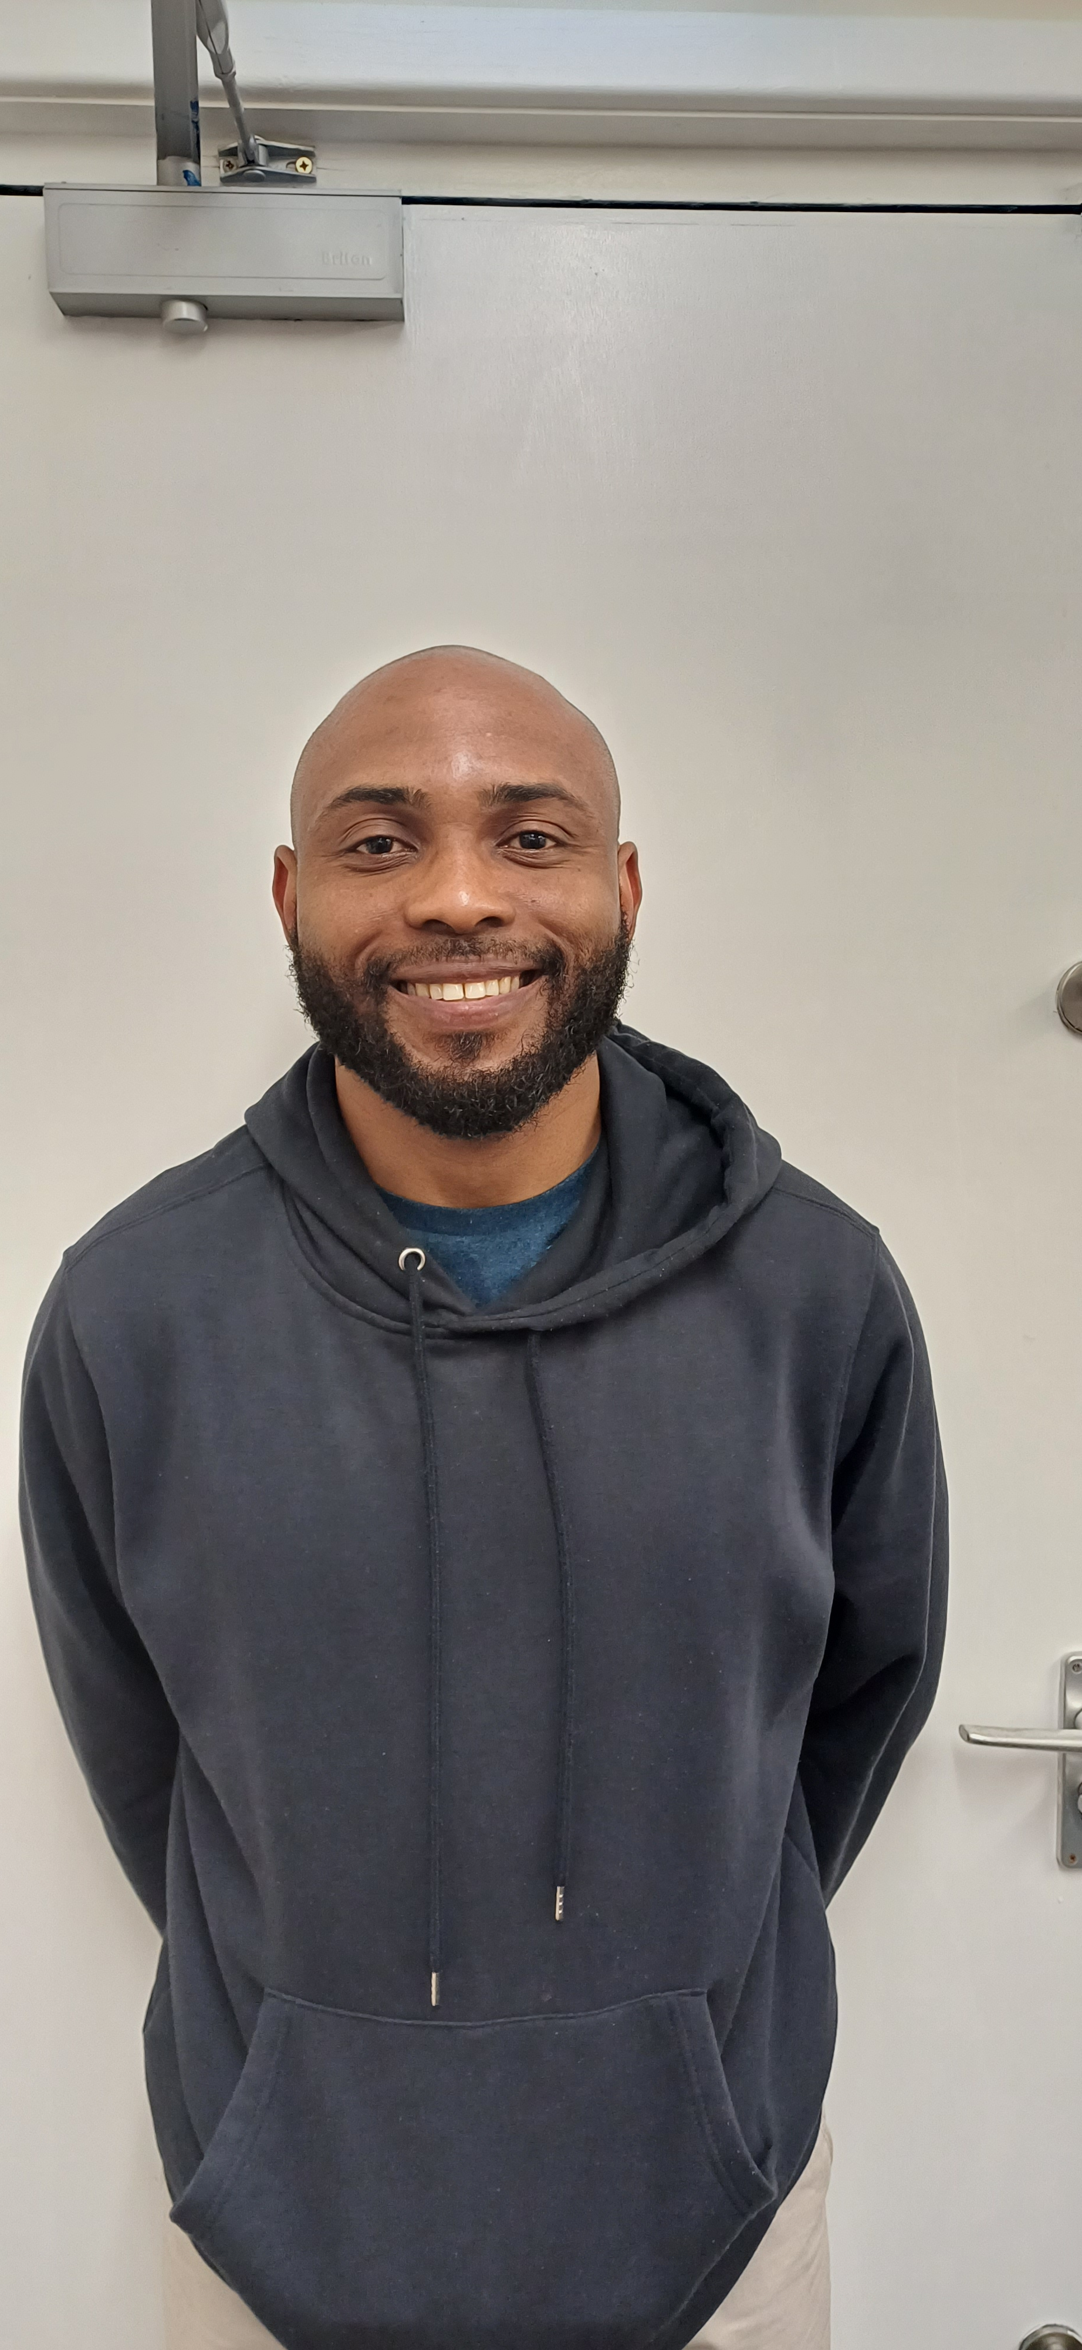
Goodbyes and Hellos
Goodbye to
Gabbi
Thursday Cook
Annette
Wednesday Storeroom
Hello to
Lisa
Thursday Living Well
Teresa
Thursday Cook
Chima
Thursday Cleaner

Slide 13



Have Your Say
The Hope Hub - Registered charity in England and Wales number 1176452

Slide 14
Safeguarding Award
Thirtyone:Eight Safeguarding Award
Proverbs 31:8
‘Speak up for those who cannot speak for themselves, for the rights of all who are destitute.’
10 Standards – Lots of criteria
Graded 1-4
Submission this Autumn
Thank you for completing the questionnaire for the THH Safeguarding Award
Notes:
Social Media – The Volunteer Handbook
Policy DV11 Social Media helps us to make appropriate decisions about the use of social media, such as blogs, wikis, social networking websites, podcasts, forums, message boards or comments on web-articles, such as Twitter, Facebook, LinkedIn or any other social media platforms.

Slide 15

Safeguarding Training
Three new THH modules in Safeguarding
Your Role and Responsibility
Recognising Abuse
Responding to a Concern
For Volunteers: Slides only (but you can see notes if your intereted)
For Staff: Slides and notes
Complete all 3 modules and a quiz for a THH Certificate in Safeguarding Vulnerable Adults
Notes:
Social Media
Updated permission to share photos, videos form and levels of sharing

Slide 16

Safeguarding
1. Your Role and Responsibility
The Hope Hub - Registered charity in England and Wales number 1176452
Notes:
Switch to alternate PPT

Slide 17
Questions – Discussion – Thoughts
The Hope Hub - Registered charity in England and Wales number 1176452

Slide 18
Living Well Portfolio
New Course in Becoming a Good Tenant
  Managing your finances
  Being a good neighbour
  Basic health and safety
  Basic DIY
See the Volunteer Web Pages for more information.

Slide 19
Questions – Discussion – Thoughts
The Hope Hub - Registered charity in England and Wales number 1176452

Slide 20
What’s Next?
Projects THH Crisis Area
HARVEST
Living Well Volunteers
Becoming a Good Tenant
Art
Brighter Days – Strengthening Wellbeing
Soup Making and Blenders
Cook Lunch Together
Take home recipes and food bags
We are clearing out as we can!
We removed everything dated 2025 so please keep a look out and give them away
CHRISTMAS
Friday 19th Dec Christmas Buffet
Tuesday 23rd Dec Christmas Lunch
The Hope Hub - Registered charity in England and Wales number 1176452

Slide 21
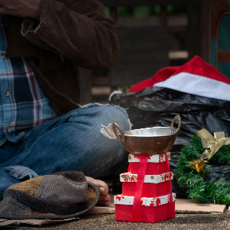
What’s Next?
EVENTS
Launch of JustGiving Winter Campaign – 20th Oct – please share among your networks
Christmas Cracker Event – 15th Nov – Camberley Town Centre – AM help to set up
Curry Club Fundraiser – 27th Nov – Save the Date
Specsavers Partnership – free clinics for Service Users
The Hope Hub - Registered charity in England and Wales number 1176452

Slide 22
What’s Next?
Volunteer Forums
STAY IN TOUCH
Thursday 20th November 2025 Online
Tuesday 20th January 2026 at THH
Wednesday 4th March 2026 Online
Thursday 4th June 2026 at THH
Volunteer Newsletter
THH Website
THH Volunteer Web Pages
THH Social Media
The Hope Hub - Registered charity in England and Wales number 1176452

Slide 23


The Hope Hub
Knoll Road, Camberley,
Surrey GU15 3SY
Tel: 01276 581174
www.thehopehub.org.uk
admin@thehopehub.org.uk
Registered Charity No: 1176452
The Hope Hub - Registered charity in England and Wales number 1176452

